Slide 1
WELCOME
TRADITION, RELIABILITY AND INNOVATION

Slide 2
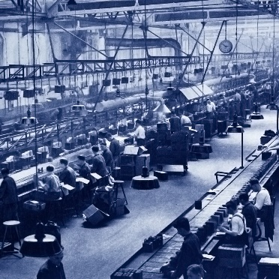
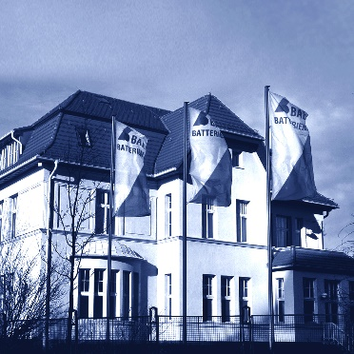
COMPANY - FACTS
QUALITY SINCE 1899
FOUNDATION 1899
BRANCH Production of Premium Lead Batteries
STATUS SME-Status
STANDARD “Quality made in Germany”
PRODUCTION 100% in Berlin
MISSION Highest reliability and lowest operational expenses
EMPLOYEES 180
EXPORT 80%

Slide 3
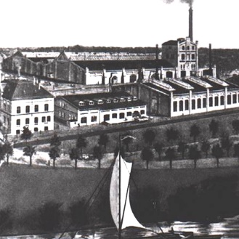
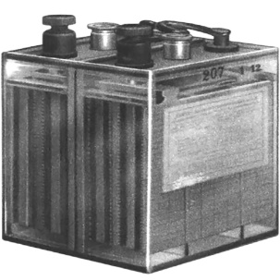
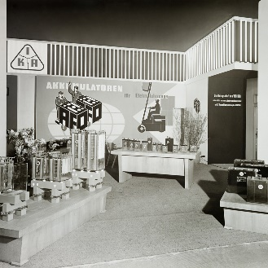
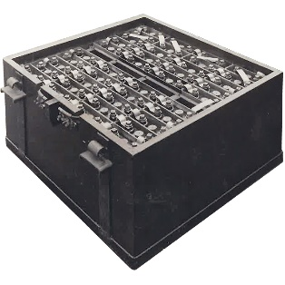
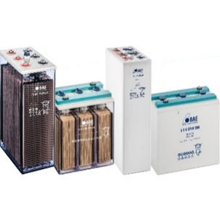
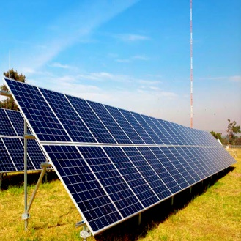
HISTORIC MILESTONES
OUR „WALK OF FAME“
1904 VARTA - Production start
1958 AFO + BELFA = BAE, Berliner Akkumulatoren-Elementefabrik
1899 Akkumulatorenwerke Oberspree was founded
1946 Akkumulatorenfabrik Oberspree, AFO
1993 BAE Berliner Batteriefabrik GmbH
2005 - … BAE Batterien GmbH
1899 Small transportable lead batteries for torches, telegraphs and annunciators
1922 Transportable lead batteries for automobiles and aircraft
1946 Akkumulatorenfabrik Oberspree, AFO
1958 Main application Railway and Forklift Batteries. 1989: 650.000 cells annually
1993 Stationary batteries: BAE OPzS and BAE OGi BAE OPzV and BAE OGiV
2005 Renewable Energy Applications

Slide 4
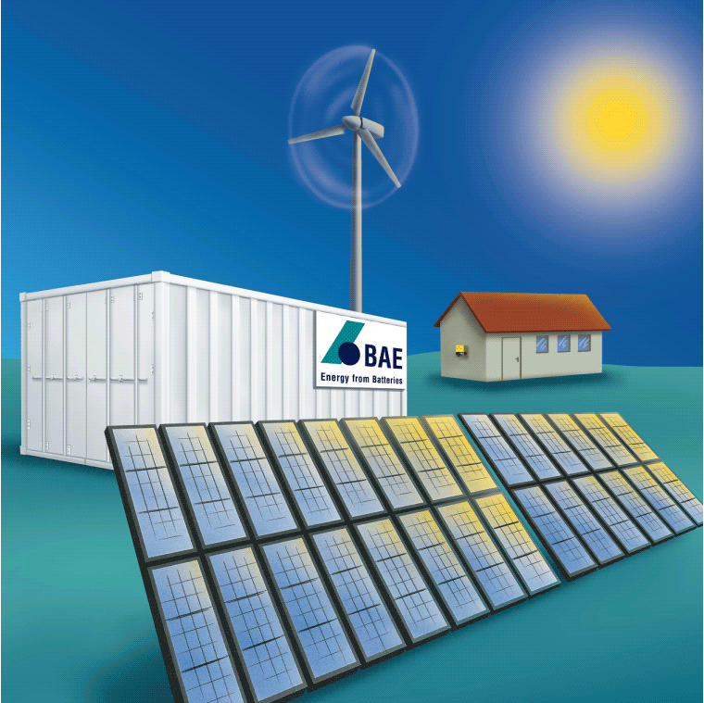
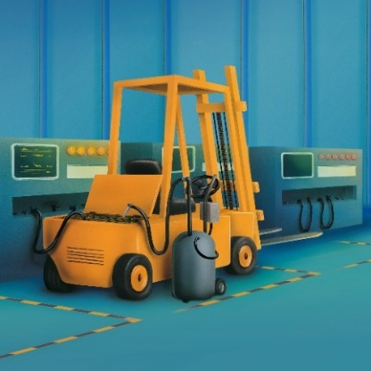
MARKET SEGMENTS
APPLICATIONS
STATIONARY APPLICATIONS
POWER PLANTS
NUCLEAR POWER PLANTS
POWER DISTRIBUTION
SUB STATIONS
TELECOMMUNICATION
INFRASTRUCTURE SYSTEMS
UPS SYSTEMS
RENEWABLE APPLICATIONS
PHOTOVOLTAIC POWER GENERATION
STAND-ALONE PHOTOVOLTAIC SYSTEMS
HYBRID APPLICATIONS
INDUSTRIAL AND RESIDENTIAL RENEWABLE ENERGY SYSTEMS
RAIL TRAFFIC APPLICATIONS
ENERGY FOR TRACTION
CRANKING
STEERING
SECURITY LIGHTING
ON-BOARD POWER SUPPLY
MOTIVE POWER APPLICATIONS
MATERIAL HANDLING EQUIPMENT
WARE HOUSE HANDLING EQUIPMENT

Slide 5
MARKET SEGMENTS 2020
MARKET APPLICATIONS
TRACTION 5%
TRACTION 5%
RAIL 7%
RAIL 7%
2020
SOLAR 16%
SOLAR 16%
STATIONARY 72%
STATIONARY 72%

Slide 6
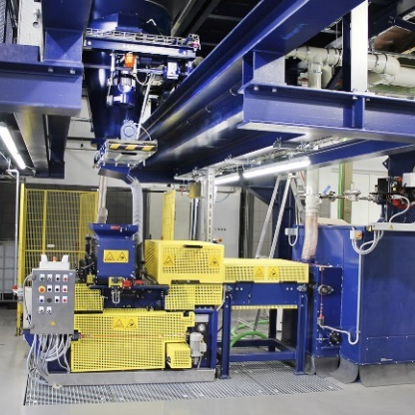
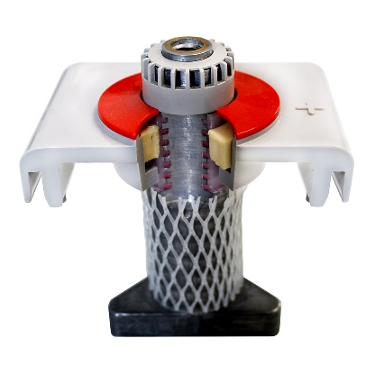
HIGHEST QUALITY STANDARDS
RESPONSIBILITY FOR HUMAN AND PRODUCT
INTEGRATED MANAGEMENT SYSTEM
TRADITIONAL WAY OF MANUFACTURING
BAE HIGH PRESSURE CASTING
DRY FILLING OF RED LEAD
TANK FORMATION
ISO 9001 CONTINUOUS QUALITY CONTROL
ISO 14001 COMPLYING WITH ALL ENVIRONMENTAL CONDITIONS
USE OF HIGH QUALITY COMPONENTS
BAE ‘’PANZERPOL’’
WOVEN GAUNTLETS
ONLY EU-28 SUPPLIERS
ISO 45001 HIGHEST SECURITY AND HEALTH STANDARDS
ISO 50001 INTEGRATED ENERGY MANAGEMENT SYSTEM

Slide 7
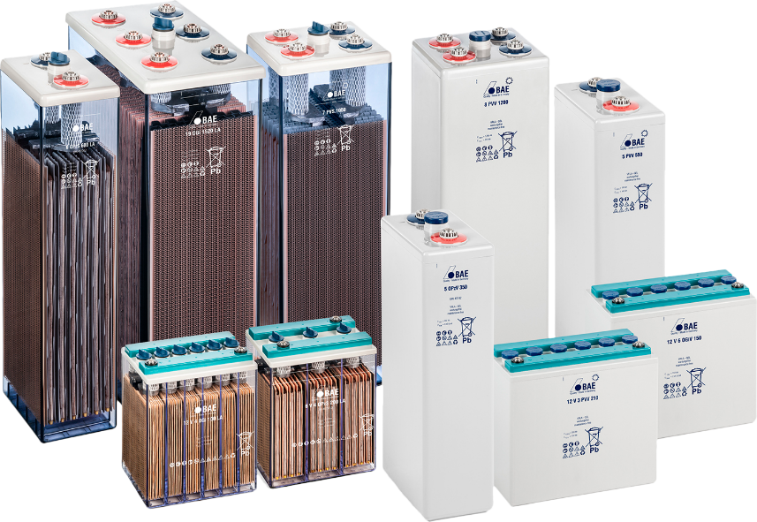
BAE SECURA PRODUCT RANGE
UNIQUE PERFORMANCE
BAE SECURA BATTERIES REFLECT OUTSTANDING QUALITY BY:
1 Perfect reliability
2 Lowest operational expenses
3 Long cycle life approved acc. to IEC 61427
4 Easy access for measurements 5 Excellent deep discharge capability 6 Protection against lid failure

Slide 8
LEAD BATTERIES ADVANTAGES
PROVEN AND SUSTAINABLE TECHNOLOGY
LEAD AS A SECURE AND RELIABLE TECHNOLOGY:
1 Low cost upfront and over the life-time
2 Safe energy storage technology
3 Easy installation & commissioning
4 Simple and cheap transportation 5 Established recycling process:
over 99% recycling rate

Slide 9
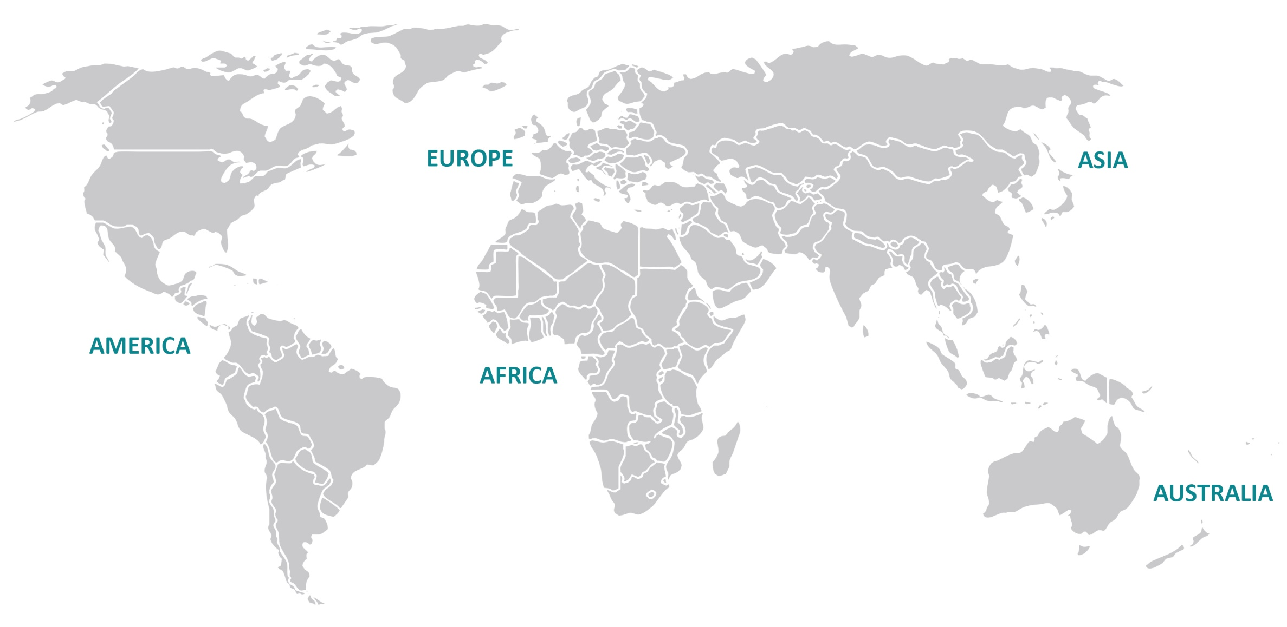
WORLDWIDE PRESENCE
OVERVIEW
PRODUCTION SITE IN BERLIN, GERMANY
REGIONAL OFFICE, SINGAPORE
BAE PARTNER

Slide 10
TOP 15 COUNTRIES 2020
OVERVIEW PERCENTAGES
USA 25%
RUSSIA 1%
THAILAND 1%
OTHER 11%
TAIWAN 2%
CANADA 2%
RUSSIA 1%
YEMEN 2%
THAILAND 1%
NETHERLANDS 2%
TAIWAN 2%
VIETNAM 3%
CANADA 2%
2020
MEXICO 3%
YEMEN 2%
GERMANY 15%
HONGKONG 3%
NETHERLANDS 2%
SPAIN 3%
VIETNAM 3%
BELGIUM 6%
MEXICO 3%
AUSTRALIA 7%
EGYPT 14%
HONGKONG 3%
GERMANY 15%
SPAIN 3%
USA 25%
EGYPT 14%
OTHER 11%
BELGIUM 6%
AUSTRALIA 7%

Slide 11
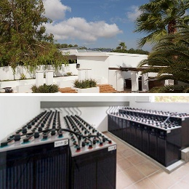
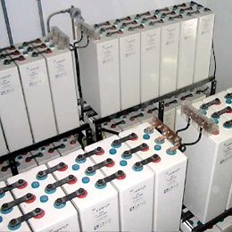
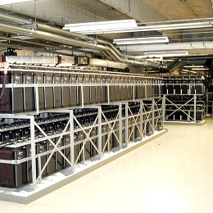
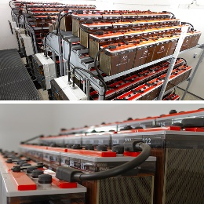
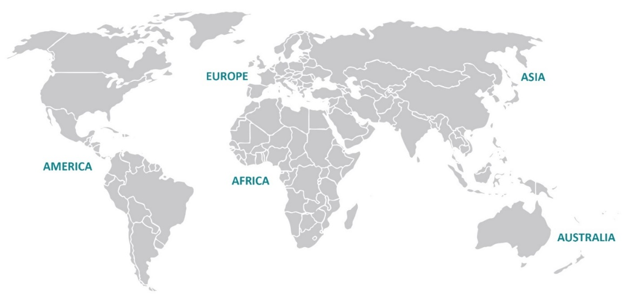
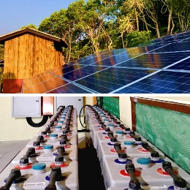
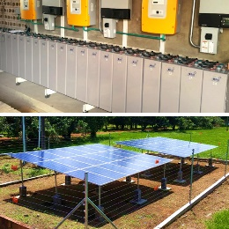
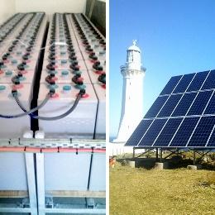
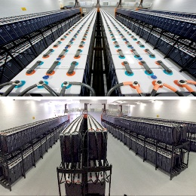
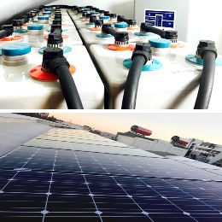
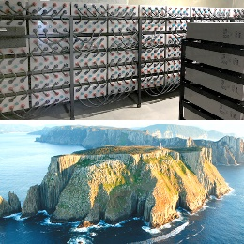
WORLDWIDE REFERENCE PROJECTS
HIGH PROFILE APPLICATIONS
SPAIN SOLAR OFF-GRID SYSTEM The 40 kW PV system, in combination with 24 BAE Secura Solar 24 PVS 4560 cells, will help to use the clean electricity for the restaurant & event complex on the island Ibiza, Spain.
RUSSIA SOLAR OFF-GRID SYSTEM The 5.5 kWp photovoltaic system, in combination with BAE Secura Solar PVV batteries, is installed on the roof at the memorial museum of cosmonautics in Moscow.
CANADA
UPS POWER SUPPLY SYSTEM
4 battery banks, each of 240 x BAE Secura 19 OGi 1520 cells, were installed as uninterruptible power supply (UPS), within the ‘’cloud’’ computing sector in Canada.
GERMANY UPS SYSTEM FOR DATA CENTER In 2012 new unit with BAE batteries was installed. This case adopts independent data center park design and provides high standard and efficiency services for users.
MYANMAR
SOLAR HYBRID SYSTEM The solar hybrid system generates all the energy for the boulder bay eco resort, located on an island (near Kawthaung in Tanintharyi region,) in Myanmar.
COLOMBIA
SOLAR OFF-GRID SYSTEM PV off-grid installations for the electrification of the Amazonas region. The first phase includes four villages in 2015, all with BAE batteries.
AUSTRALIA SOLAR OFF-GRID SYSTEM The BAE battery bank as an energy storage system, in combination with the solar power panels, provides the power for the Green Cape Lighthouse in New South Wales, Australia.
SOUTH AFRICA
UPS PROJECT – 4 MVA Four battery banks, each of 264 x BAE Secura 25 OGi 2000 cells, were installed in the iThemba LABS sub-atomic particle accelerator, in the Western Cape.
MOROCCO
RESIDENTIAL SOLAR ON-GRID SYSTEM The objective of the system is to reduce reliance on the residential property in Casablanca on-grid electricity consumption. The 24 V battery bank consists of BAE Secura 9 OPzV 900 “maintenance-free” batteries, feeding the night-time loads.
AUSTRALIA SOLAR HYBRID SYSTEM The battery bank of 60 x BAE Secura Solar 26 PVV 4940 cells as an energy storage system in combination with solar panels of 57 kWp are powering the tourist centre located on Bruny Island south west of Hobart Tasmania.

Slide 12
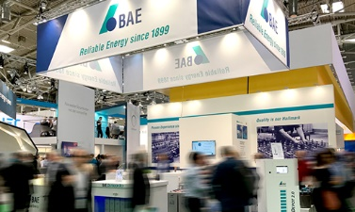
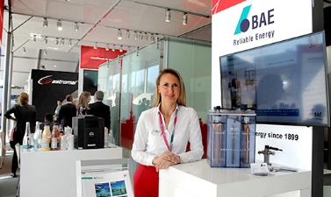
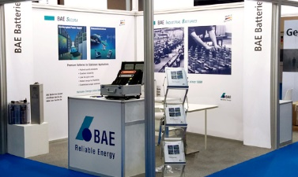
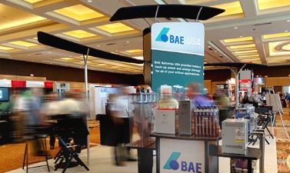
WORLDWIDE PRESENCE
EXTRACT TRADE FAIRS PARTICIPATIONS
GERMANY - MUNICH EES / INTERSOLAR
GERMANY - HANNOVER HANNOVER MESSE
GERMANY - MUNICH EES / INTERSOLAR, BAE - BOOTH
GERMANY - BERLIN INNO TRANS
FRANCE - PARIS
EUROPEAN UTILITY WEEK
RUSSIA - MOSCOW POWER GRIDS
USA - FLORIDA
BATTCON
THAILAND - BANGKOK
REA - RENEWABLE ENERGY ASIA
POLAND – GDANSK TRAKO, INFOPOINT - GERMAN PAVILION
SOUTH AMERICA - COLOMBIA
EXPO SOLAR
SPAIN - MADRID
GENERA
MALAYSIA - KUALA LUMPUR TENAGA – EXPO & FORUM
AFRICA - ACCRA
WACEE
UNITED ARAB EMIRATES - ABU DHABI WFES - WORLD FUTURE ENERGY SUMMIT
UNITED ARAB EMIRATES - DUBAI MIDDLE EAST ENERGY, BAE - BOOTH
UNITED ARAB EMIRATES - DUBAI MIDDLE EAST ENERGY - DUBAI
USA - FLORIDA
BATTON, BAE - BOOTH

Slide 13
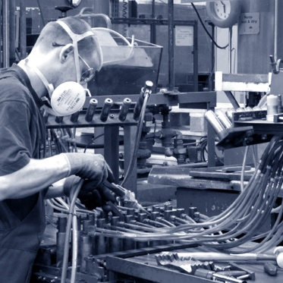
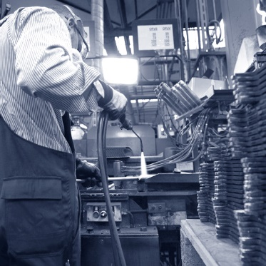
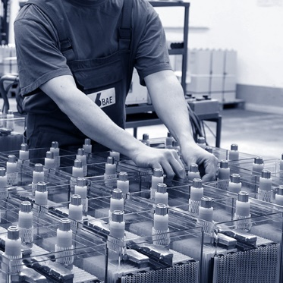
SUMMARY
UNIQUE SELLING POINTS
120 years of history in manufacturing high-quality industrial lead batteries
Sole premium producer with only production in Germany
Highly flexible organization and process-orientated structure
Unique product features and customized products
Outstanding quality, life-time and reliability of products enabling lowest OPEX
High-end customers relying on BAE since many years
Long-term business strategy and reliable partnerships

Slide 14
THANK YOU
FOR YOUR ATTENTION!
TRADITION, RELIABILITY AND INNOVATION

