Slide 1


German quality solutions for Romania since 1979
Dominik Hammer
SUNSET Energy Group
www.sunset-solar.com

Slide 2







AT A GLANCE
Privately-owned company (GmbH), founded in 1979
Head office in Adelsdorf , Germany
Producer and system-house
Cooperation with various other Companies
and many more….

Slide 3
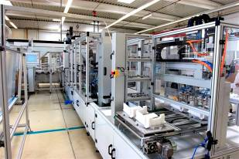
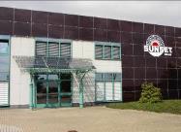
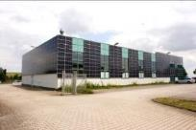

COMPANY PROFILE - Factory PV
German Manufacturing of the
SUNpremium® Module Series

Slide 4
PRODUCTS
Grid-connected solar power systems
Off grid systems, solar-home-systems, etc.
Solar pumping systems
Solar hot water systems
Solar pool heating systems
Consumer products
One stop shopping at SUNSET

Slide 5
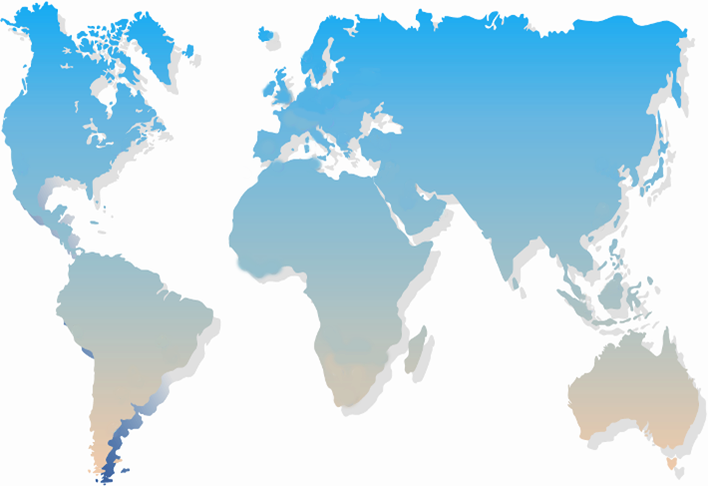

SUNSET ENERGY GROUP

Slide 6
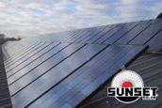
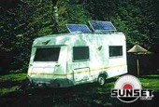
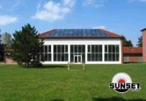
OUR SECTORS
SOLAR POWER SYSTEMS
SOLAR POWER SYSTEMS
SOLAR HOT WATER SYSTEMS
SOLAR CONSUMER PRODUCTS

Slide 7
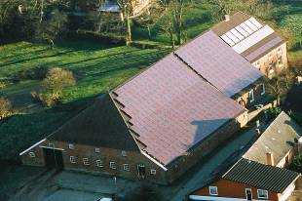
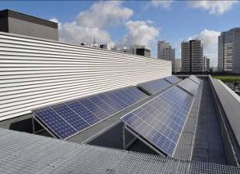
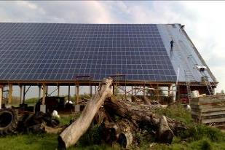
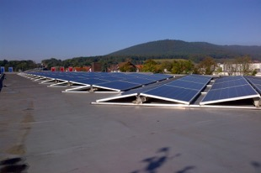
ON GRID SYSTEMS
for all different kind of roofs

Slide 8
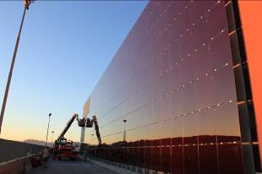
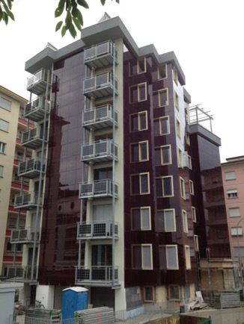
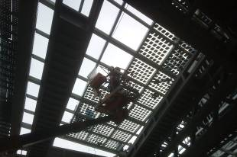
ON GRID SYSTEMS
BIPV
“Building integrated PV”

Slide 9
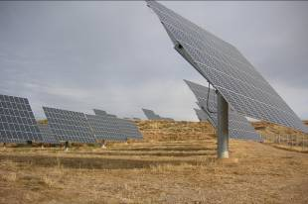
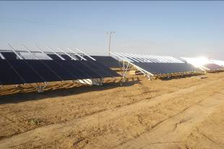
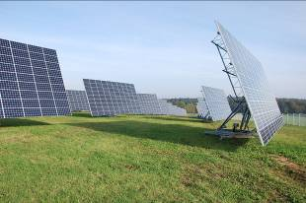
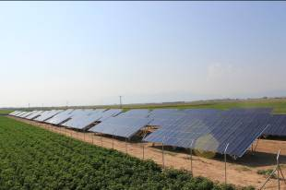
ON GRID SYSTEMS
SUNpremium®
field structure

Slide 10
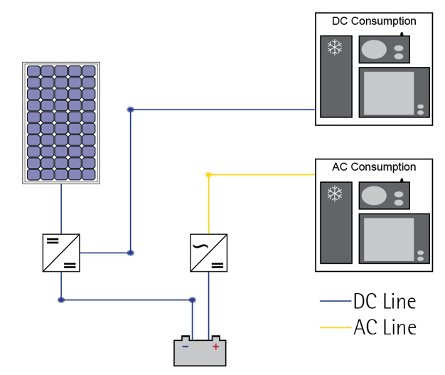
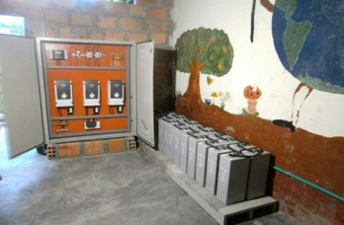
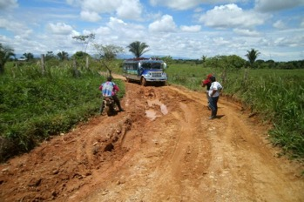
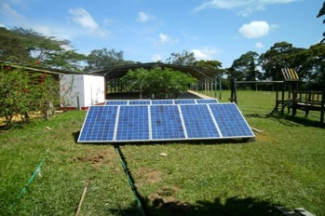
STANDARD OFF GRID SYSTEM

Slide 11
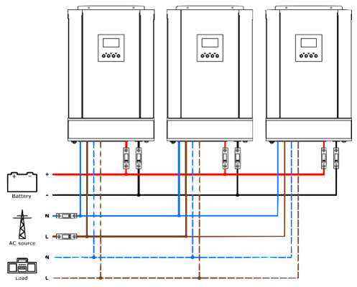
HYBRID SYSTEMS
single or threephase
Option to include the (public) grid and/or a diesel genset
Option to include windpower or other alternative forms of energy
Optimized efficiency through a mix of AC and DC coubling
SUNisland

Slide 12
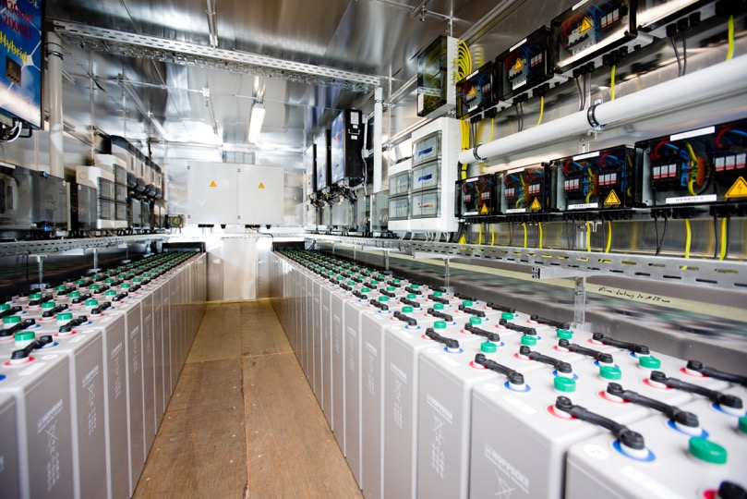
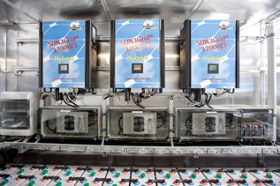
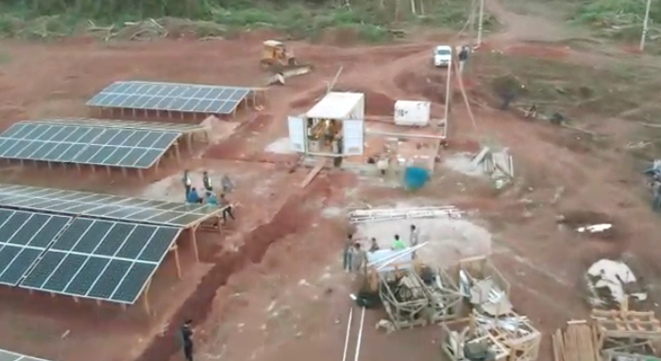
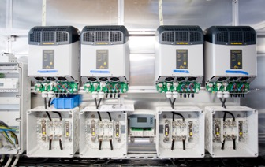
SUNcube -customized turnkey solutions

Slide 13
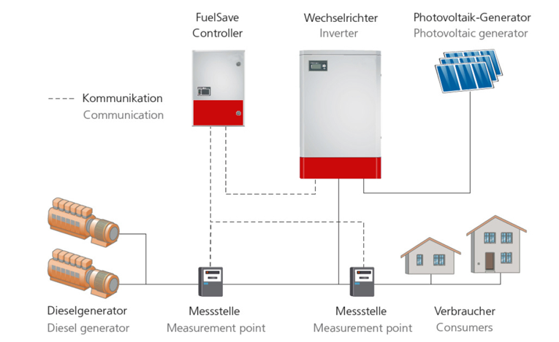
PV-DIESEL HYBRID SYSTEM
Fuel Saver

Slide 14
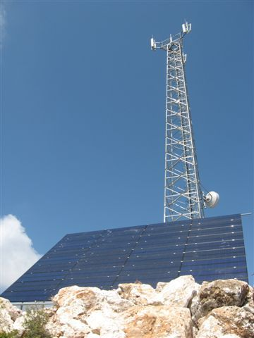
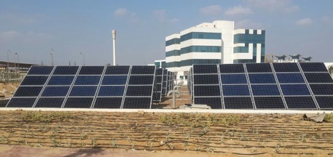
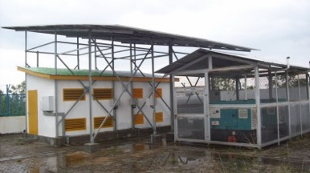
PV-DIESEL HYBRID SYSTEM
Fuel Saver

Slide 15
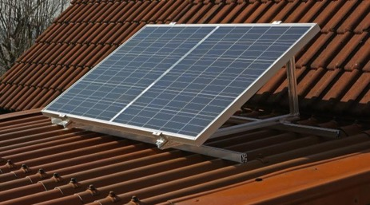
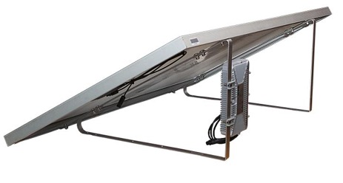
ON GRID SYSTEM – SUNpay®
The ideal pre-installed solution to reduce the energy bill.
„plug&play“ grid connected system
simple installation suitable for nearly every country worldwide.
extendable up to 12 SUNpay® systems
one system for different mounting solutions
SUNpay®

Slide 16
OUR SECTORS
SOLAR POWER SYSTEMS
SOLAR HOT WATER SYSTEMS
SOLAR HOT WATER SYSTEMS
SOLAR CONSUMER PRODUCTS

Slide 17
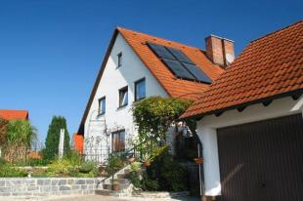
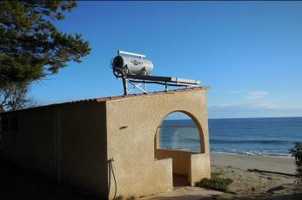
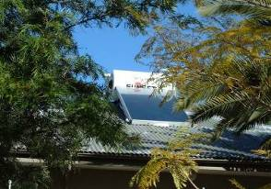
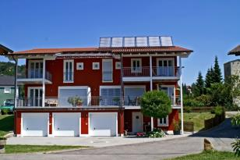
HOT WATER SYSTEMS
for all different kind of roofs

Slide 18
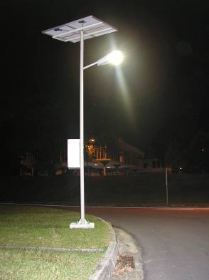
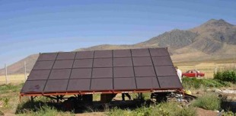
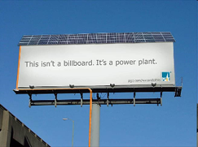
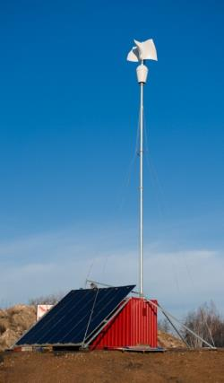
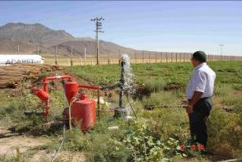
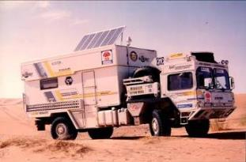
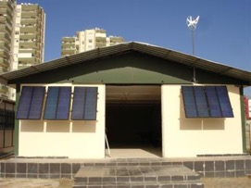
FURTHER PRODUCTS

Slide 19


From the beginning……
The world‘s future energy ® by
Dominik Hammer
Tel: +49 (0) 9195-9494-0
dominik.hammer@sunset-solar.com

