Slide 1
How Low Voltage Network Monitoring Enables and Accelerates the Energy Transition
Energie-Geschäftsreise Rumänien
September 2024, Dirk ter Haar

Slide 2

WHAT ARE THE PROBLEMS THAT WE HELP SOLVE?

Slide 3

VOLTAGE VIOLATIONS
caused by solar installations
Measure real levels
Improve models
Identify where to intervene
Allow more connections
Implement demand turn up

Slide 4

NOT KNOWING…
… where you have congestion
How to prioritize reinforcement work.
Where/how to utilize existing infrastructure and assets better.
How to make models more accurate.

Slide 5

HOW TO CONNECT…
… more low carbon technologies
Identify headroom
Enable flexible connections
Enable Flexibility Trading
Focus your resources on the most critical points in your network

Slide 6
HOW TO REDUCE…
… my operating costs
Reduce neutral line loads caused by phase asymmetry.
Identify and improve phase angle issues.
Dispatch technicians more accurately to where they are needed.

Slide 7

HOW DO WE DO THIS?

Slide 8
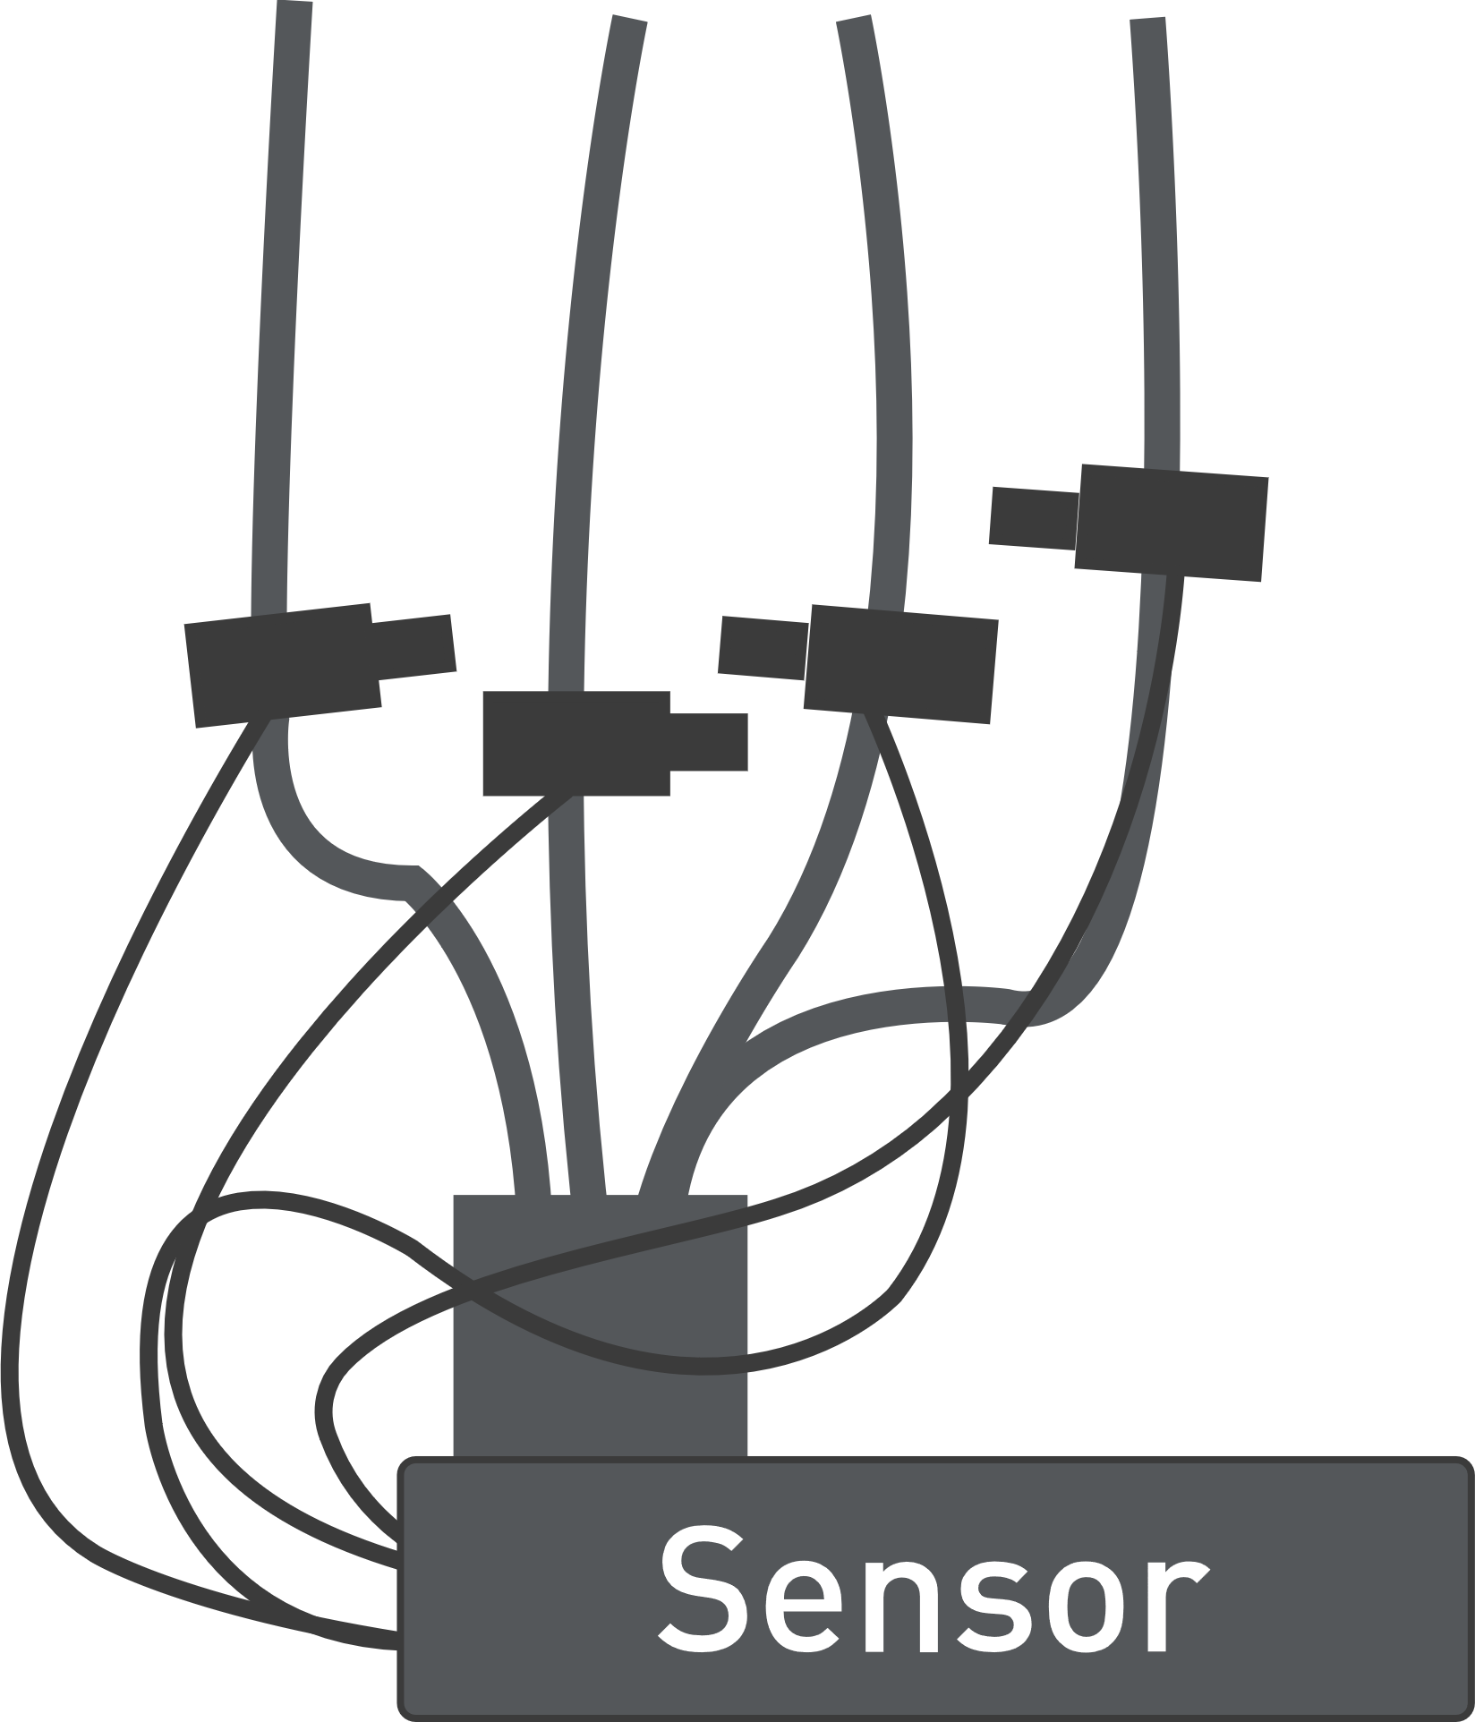
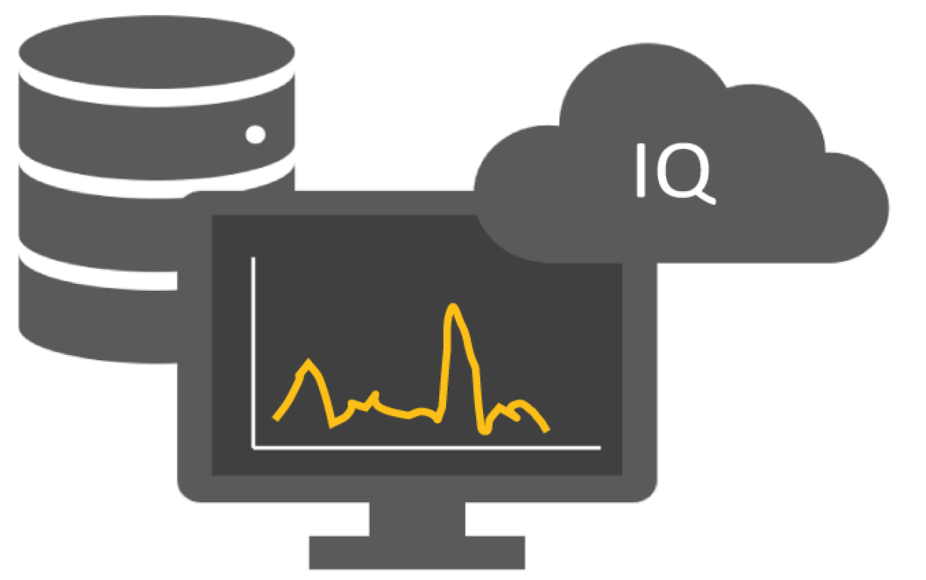

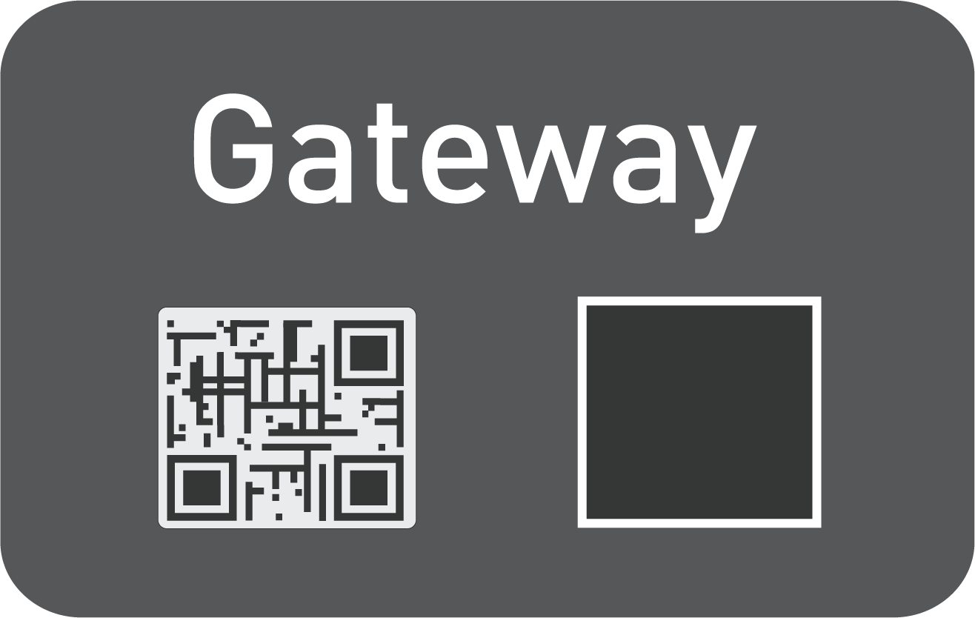
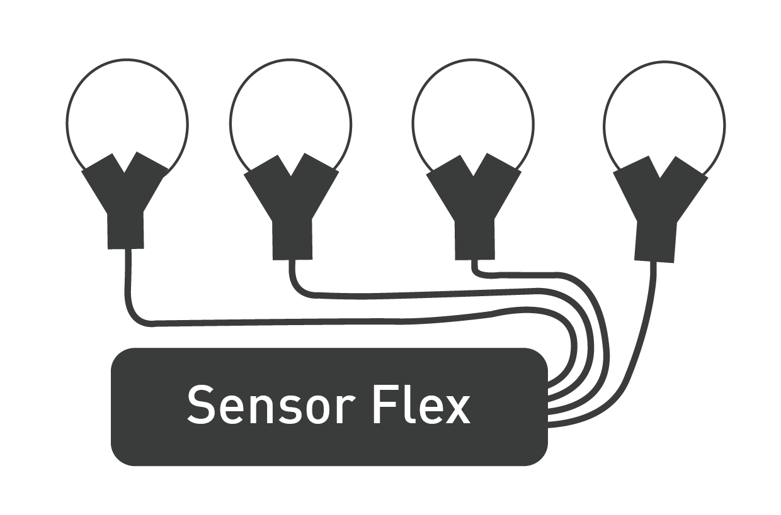
IoT SOLUTION
SMIGHT Grid2 makes the distribution grid intelligent in retrofit!
Server
Infrastructure
Sensors – record the effective value of the current, the current with flow direction and phase angle (cos φ) per feeder and 1x per minute.
Gateway – measures one rail voltage and securely transmits the measured data as 15-min values via LTE to the SMIGHT IQ IoT platform.
The devices are continuously monitored and updated by SMIGHT.
SMIGHT IQ Cloud – stores the data securely in a German data center (ISO 27001).
Current and voltage curves are visualized in the web portal and can be transferred to other systems.
Notes:
Gateway: überträgt per LTE, durch VPN-Tunnel gesichert, die Messdaten an die SMIGHT IoT-Plattform.
Die Verbindung wird von SMIGHT konstant überwacht und kann für Over-the-Air Updates genutzt werden.

Slide 9
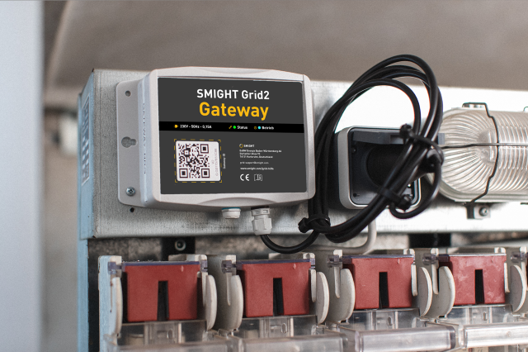
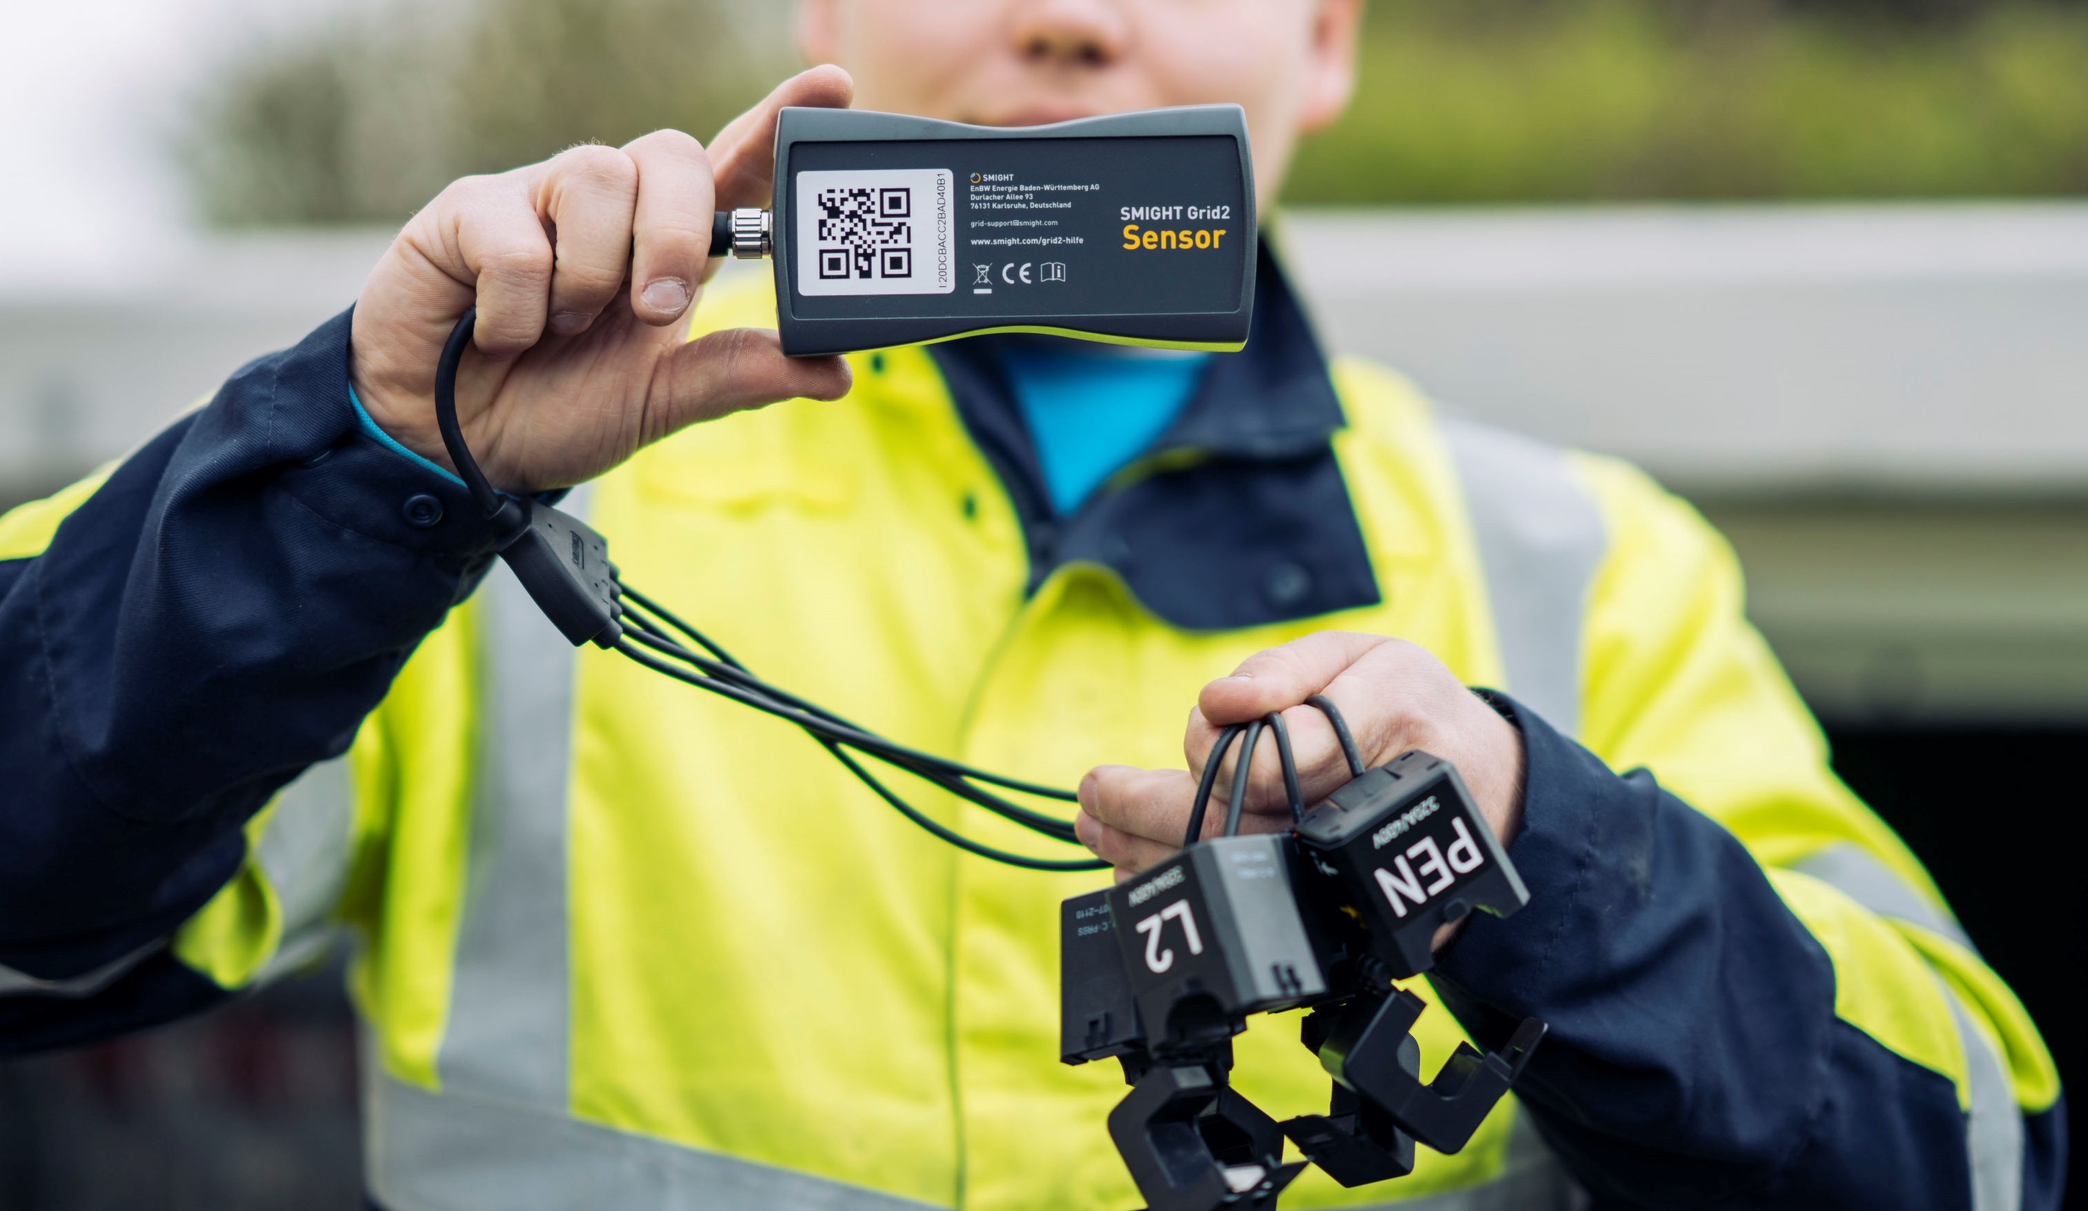
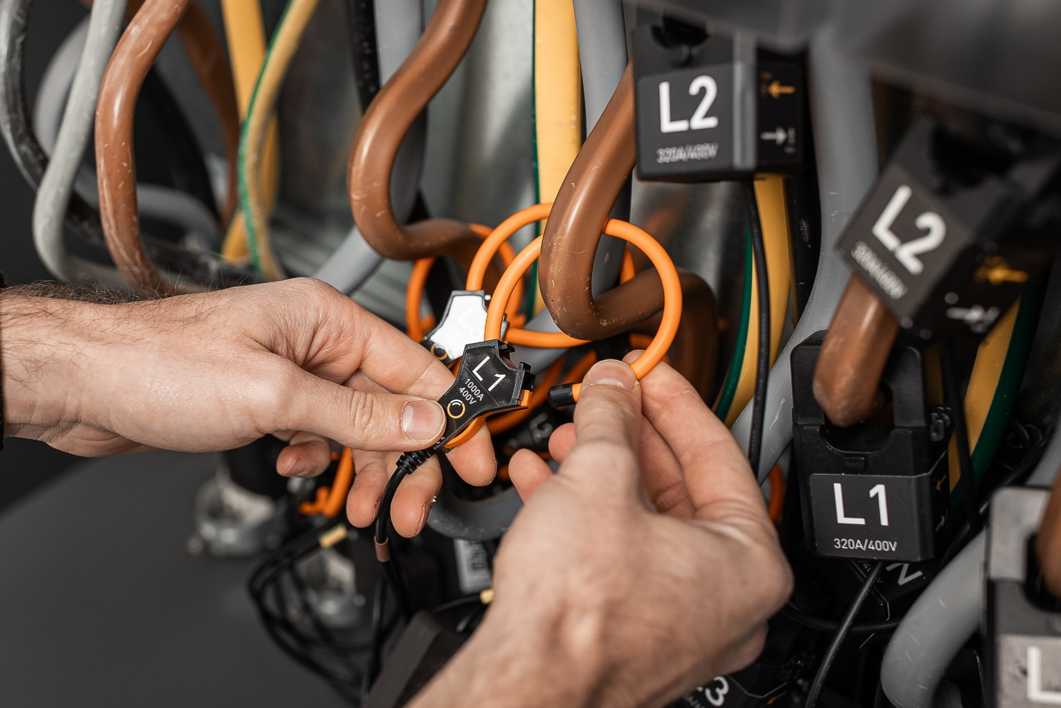
FAST & EASY TO INSTALL
Developed with the needs of DSOs in mind
Retrofit of secondary substations and distribution cabinets even with limited space
Fast installation in under 1h by your own technician during running operation
No live-line working required - installation during operation
Reduced cabling effort
Notes:
Reduzierter Verkabelungsaufwand durch Funkübertragung zwischen Sensor & Gateway

Slide 10

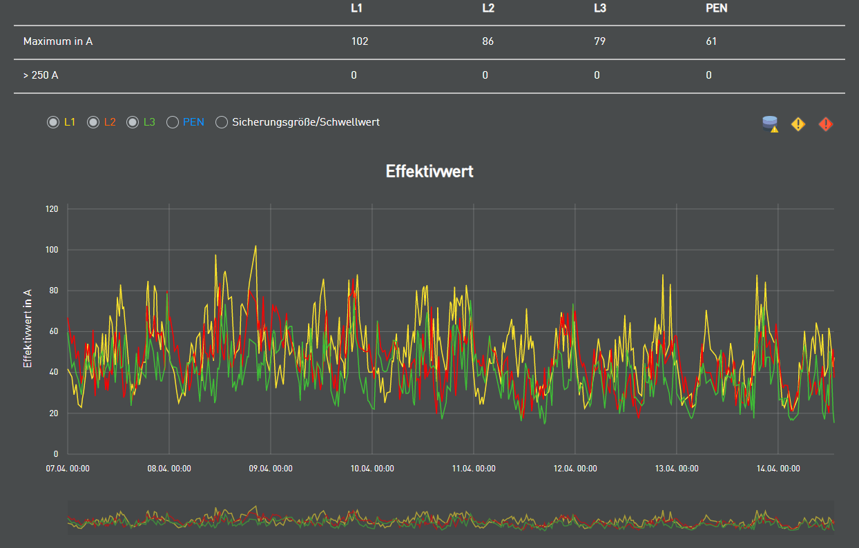

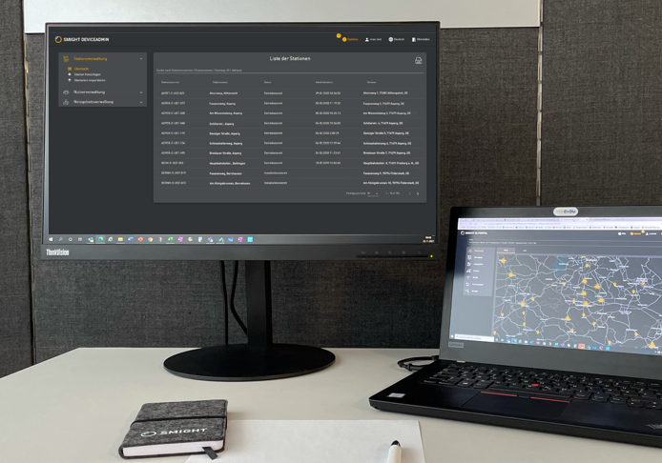

1, 2, 3, … UPGRADE!
Make existing infrastructure intelligent in only 4 steps
#3
Technician activates station with app and QR code
#1
Adding stations and users in Device admin
5 min
#2
Technician installs gateway and sensors
#4
Measurement data are available: Current per feeder and phase
40-50 min
after approx.
15 min

Slide 11

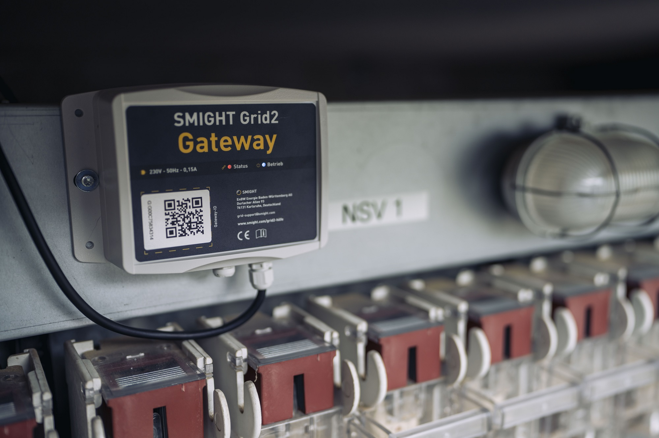
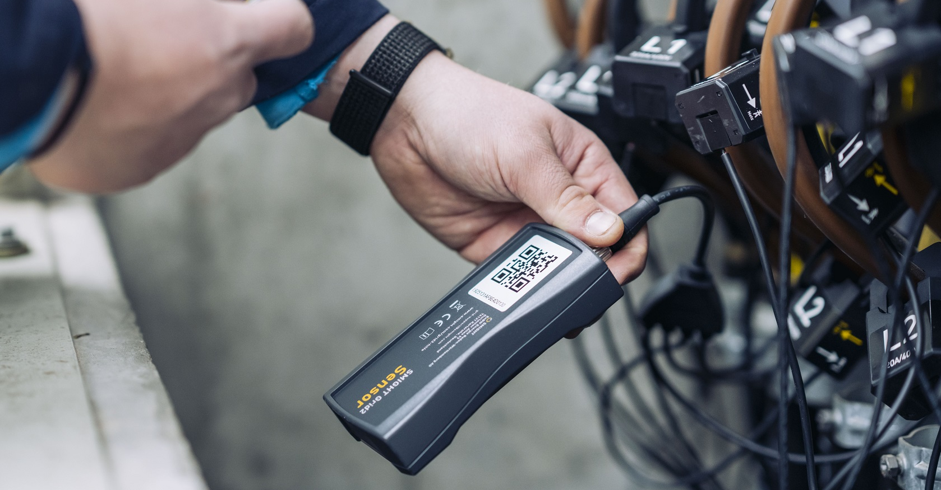

Notes:
Hier ZwDiskussion: Eindrücke, Fragen

Slide 12
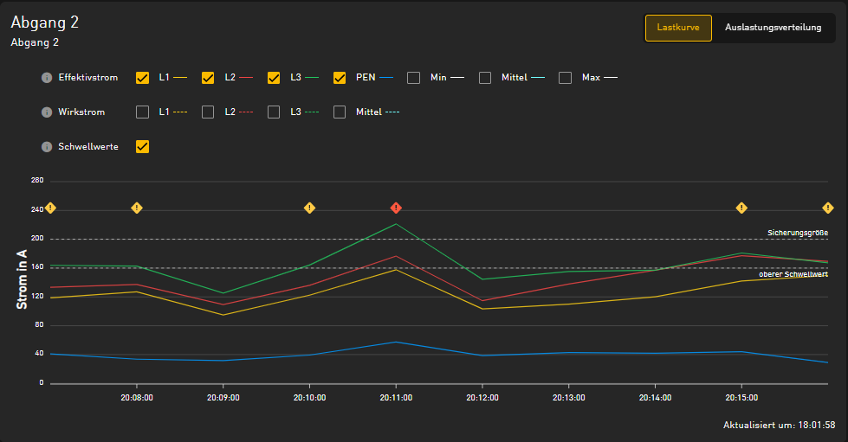



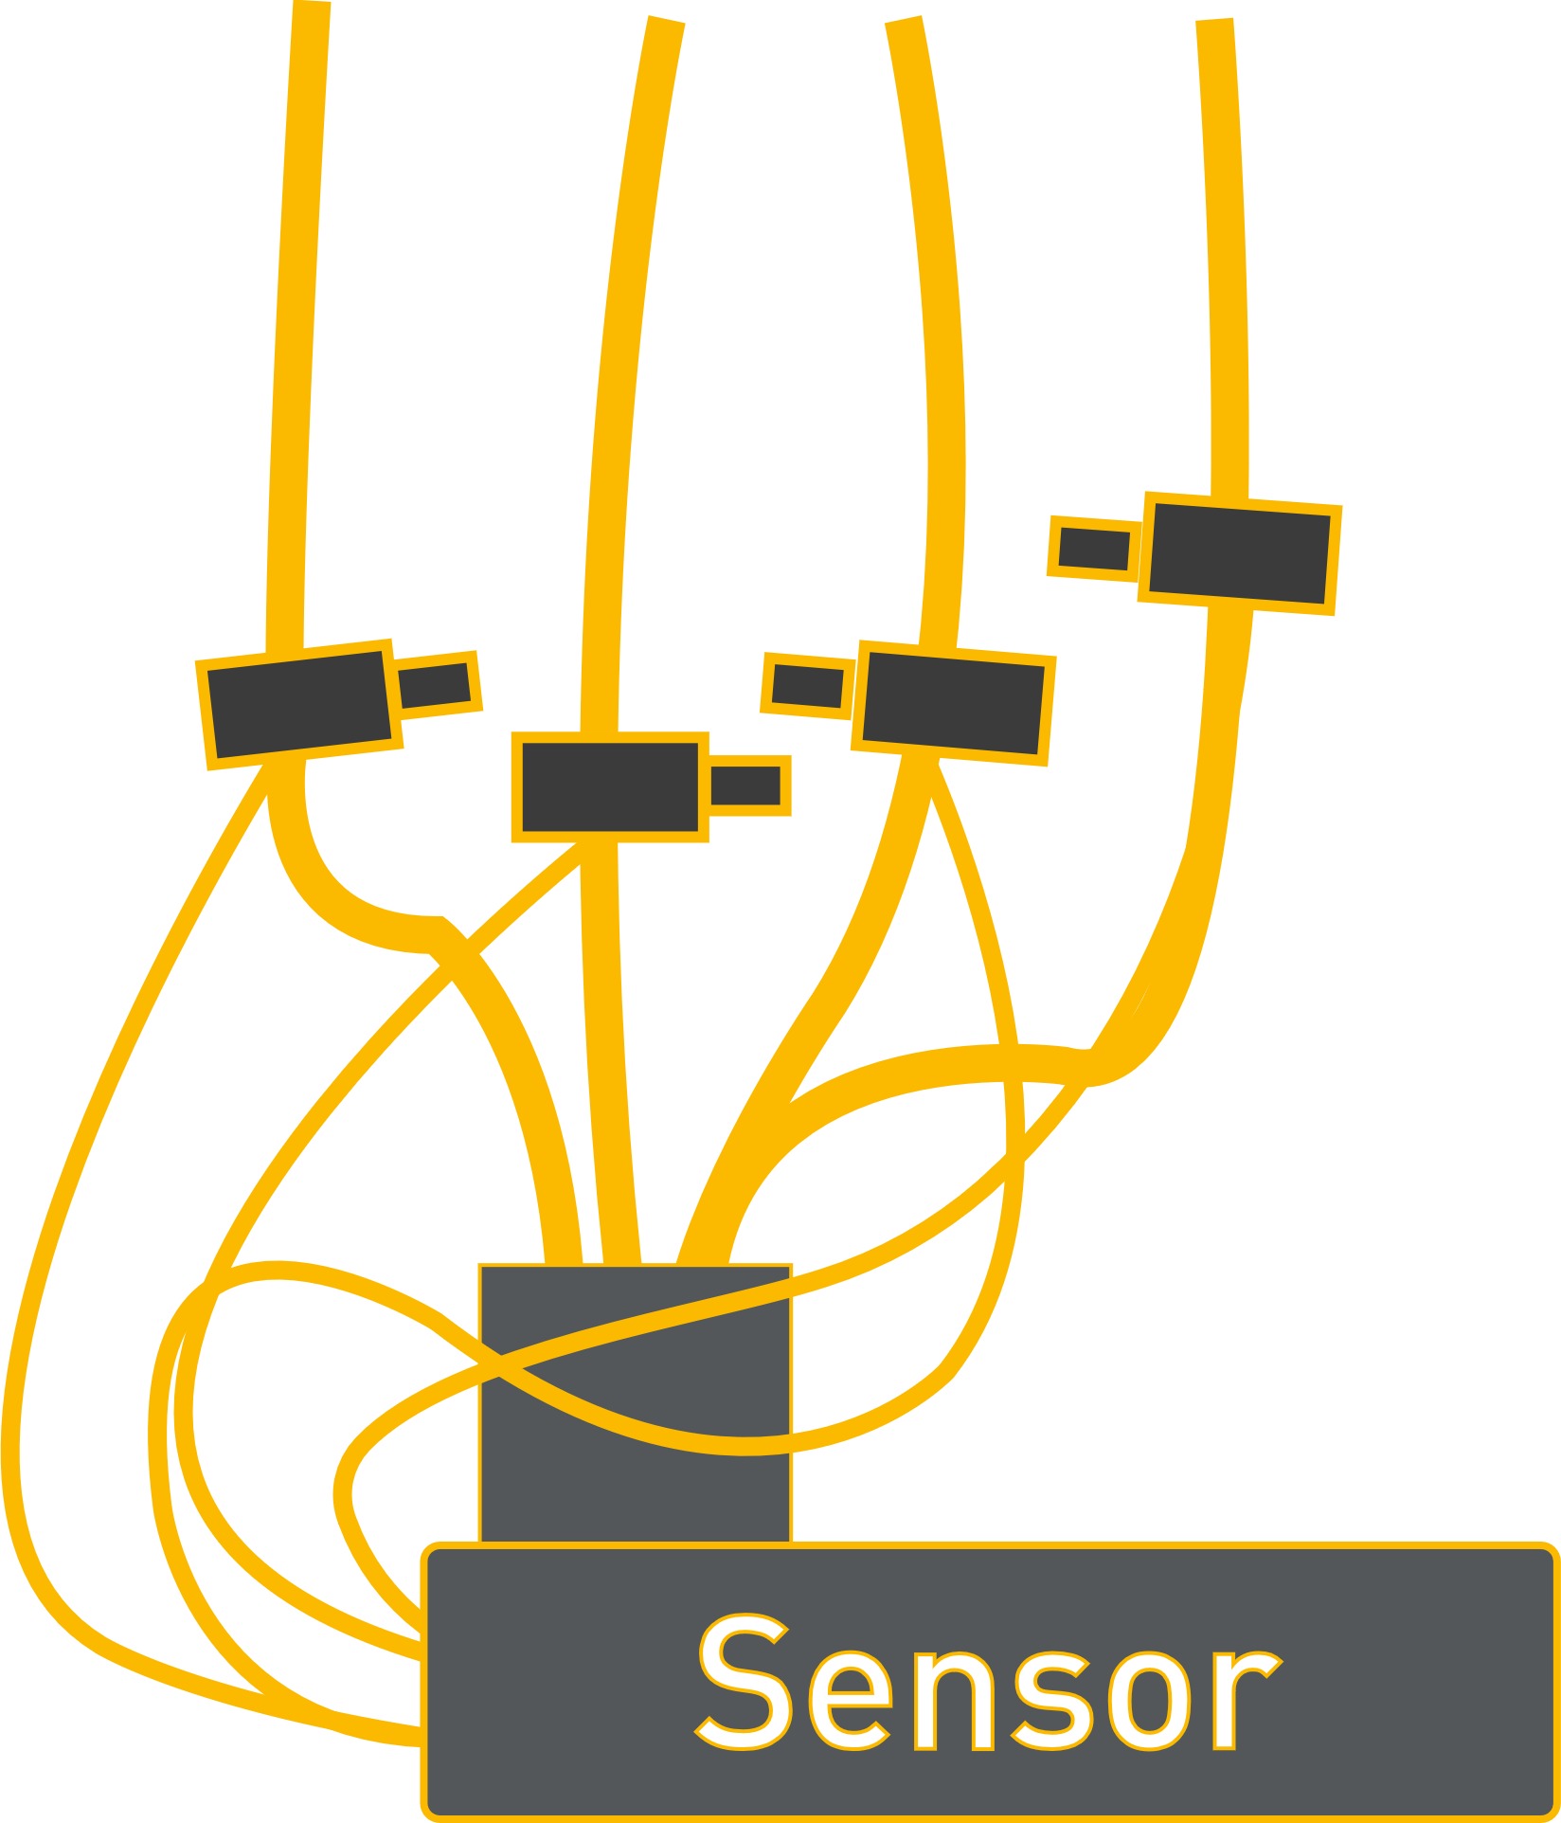

SMIGHT GRID2 DATA FLOWS
Data Usage Possibilities
SMIGHT IQ Cockpit
Schwellwert-benachrichtigung
Monats Report
SMIGHT IQ Cloud
ISO 27001 Certified Data Centre in Frankfurt
Without an IT Project
Other Systems
Sensor data
Device data
API
…
NePlan, PowerFactory, etc.
Flexibility Platforms
Notes:
Zweite Version bauen
IQ mit Portal und Dashboard und reports
"Beratung" besseres wort finden – darunter fallen die use cases
API – lassen wie et is

Slide 13




















IoT Expertise & Grid Operator DNA
We are helping DSOs enable the energy transition
100.000
measuring
points
8
years
38
experts
> 120 DSO
customers
experience with
sensors & IoT
technology
with grid history & grid know-how
in 4000 substations of European grid operators
German market leader for real-time grid monitoring

