Slide 1


Beyond Technology:
How the right RTU Partner defines the DSO Success in Grid Digitalization?

Slide 2








LACROIX
CONNECTED
TECHNOLOGIES FOR
An international,
tech & industrial midcap
For road systems
infrastructure operators
For utilities
infrastructure operators
City
activity
Environment
activity
Street lighting
Water & wastewater
Traffic management & C-ITS
(cooperative intelligent transport systems)
Deliver equipment & solutions to optimize & secure
smart road
infrastructures
Deliver equipment & solutions to optimize & secure
water & energy
infrastructures
Smart Grids
Passenger information system
Electronics
activity
HVAC
(Heating, Ventilation,
Air Conditioning)
€761M
Revenue in 2023
For technology &
industry leaders
Deliver end-to-end
services from design
to manufacturing
of electronic
equipment
Automotive
HBAS
(Home & building automation)
Industrial
Avionics & defense
Healthcare
~5,100
Collaborators in 2023
Become a global leader in industrial IoT solutions & electronic equipment for
critical applications
OUR AMBITION
Located in
13 countries
EMEA ~ 75% revenue
NORTH AMERICA ~ 25% revenue
APAC
FRANCE
GERMANY
SPAIN
USA
SINGAPORE
CHINA
POLAND
ITALY
BELGIUM
TUNISIA
MOROCCO
SAUDI ARABIA
MEXICO
This document is proprietary and confidential to LACROIX and may not be reproduced without prior authorization.
Notes:
(Around 5,100 collaborators including 4,000 LACROIX employees and 1,100 collaborators in Mexico under specific local contract)
LACROIX IS AN INTERNATIONAL TECHNOLOGICAL & INDUSTRIAL MIDCAP, WITH A €761M REVENUE FOR 2023;
& AROUND 5,100 EMPLOYEES IN 13 COUNTRIES AROUND THE WORLD.
LACROIX IS BUILT AROUND 3 COMPLEMENTARY ACTIVITIES:
ELECTRONICS ACTIVITY, WHICH DELIVERS END-TO-END SERVICES
FROM DESIGN TO MANUFACTURING OF ELECTRONICS EQUIPMENT FOR THE AUTOMOTIVE, INDUSTRIAL,
HOME & BUILDING AUTOMATION, AVIONICS & DEFENSE, AND HEALTHCARE MARKETS.
CITY & ENVIRONMENT ACTIVITIES WHICH DELIVER EQUIPMENT & SOLUTIONS TO OPTIMIZE & SECURE
SMART ROAD, WATER AND ENERGY INFRASTRUCTURES.
OUR AMBITION: TO BECOME A GLOBAL LEADER IN INDUSTRIAL IOT SOLUTIONS & ELECTRONIC EQUIPMENT FOR CRITICAL APPLICATIONS.

Slide 3
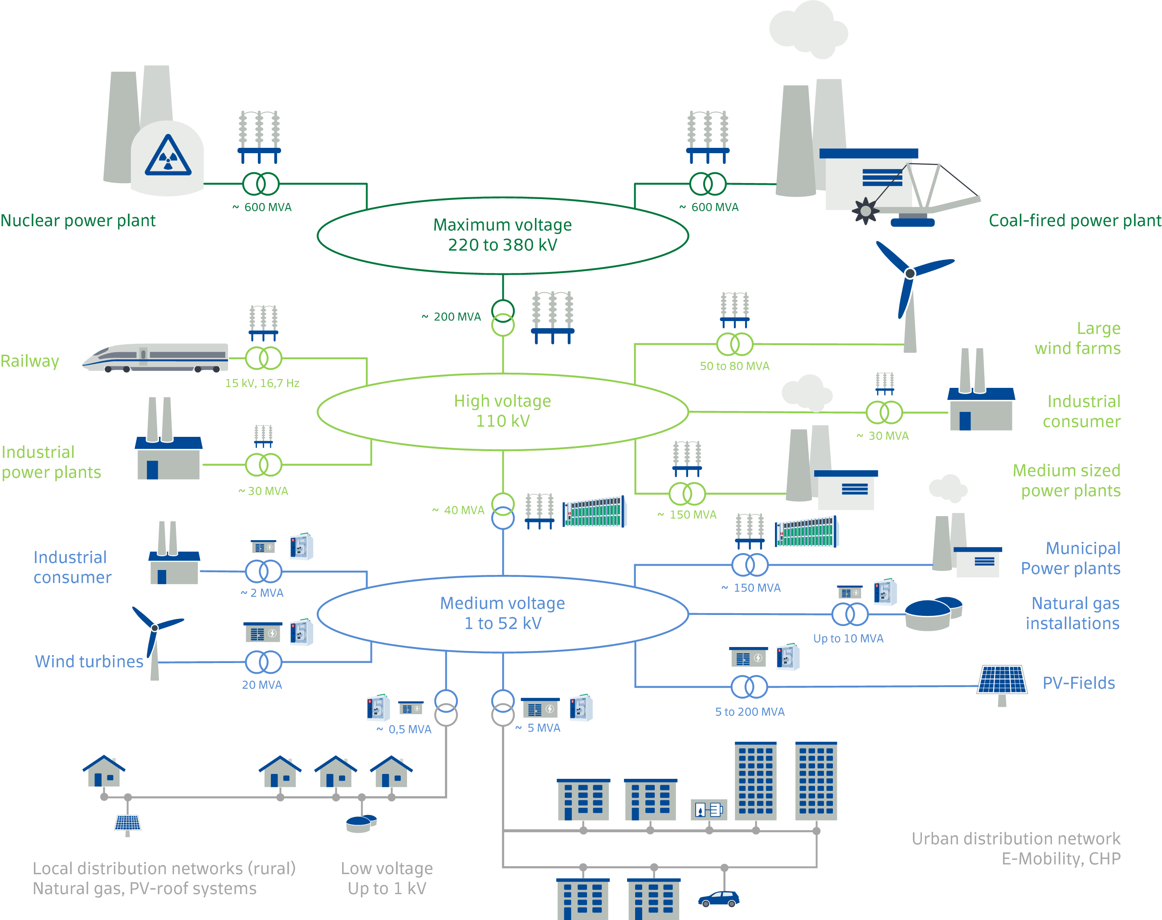

Where do we focus?
Classification in the power grid
This document is proprietary and confidential to LACROIX and may not be reproduced without prior authorization.
3

Slide 4
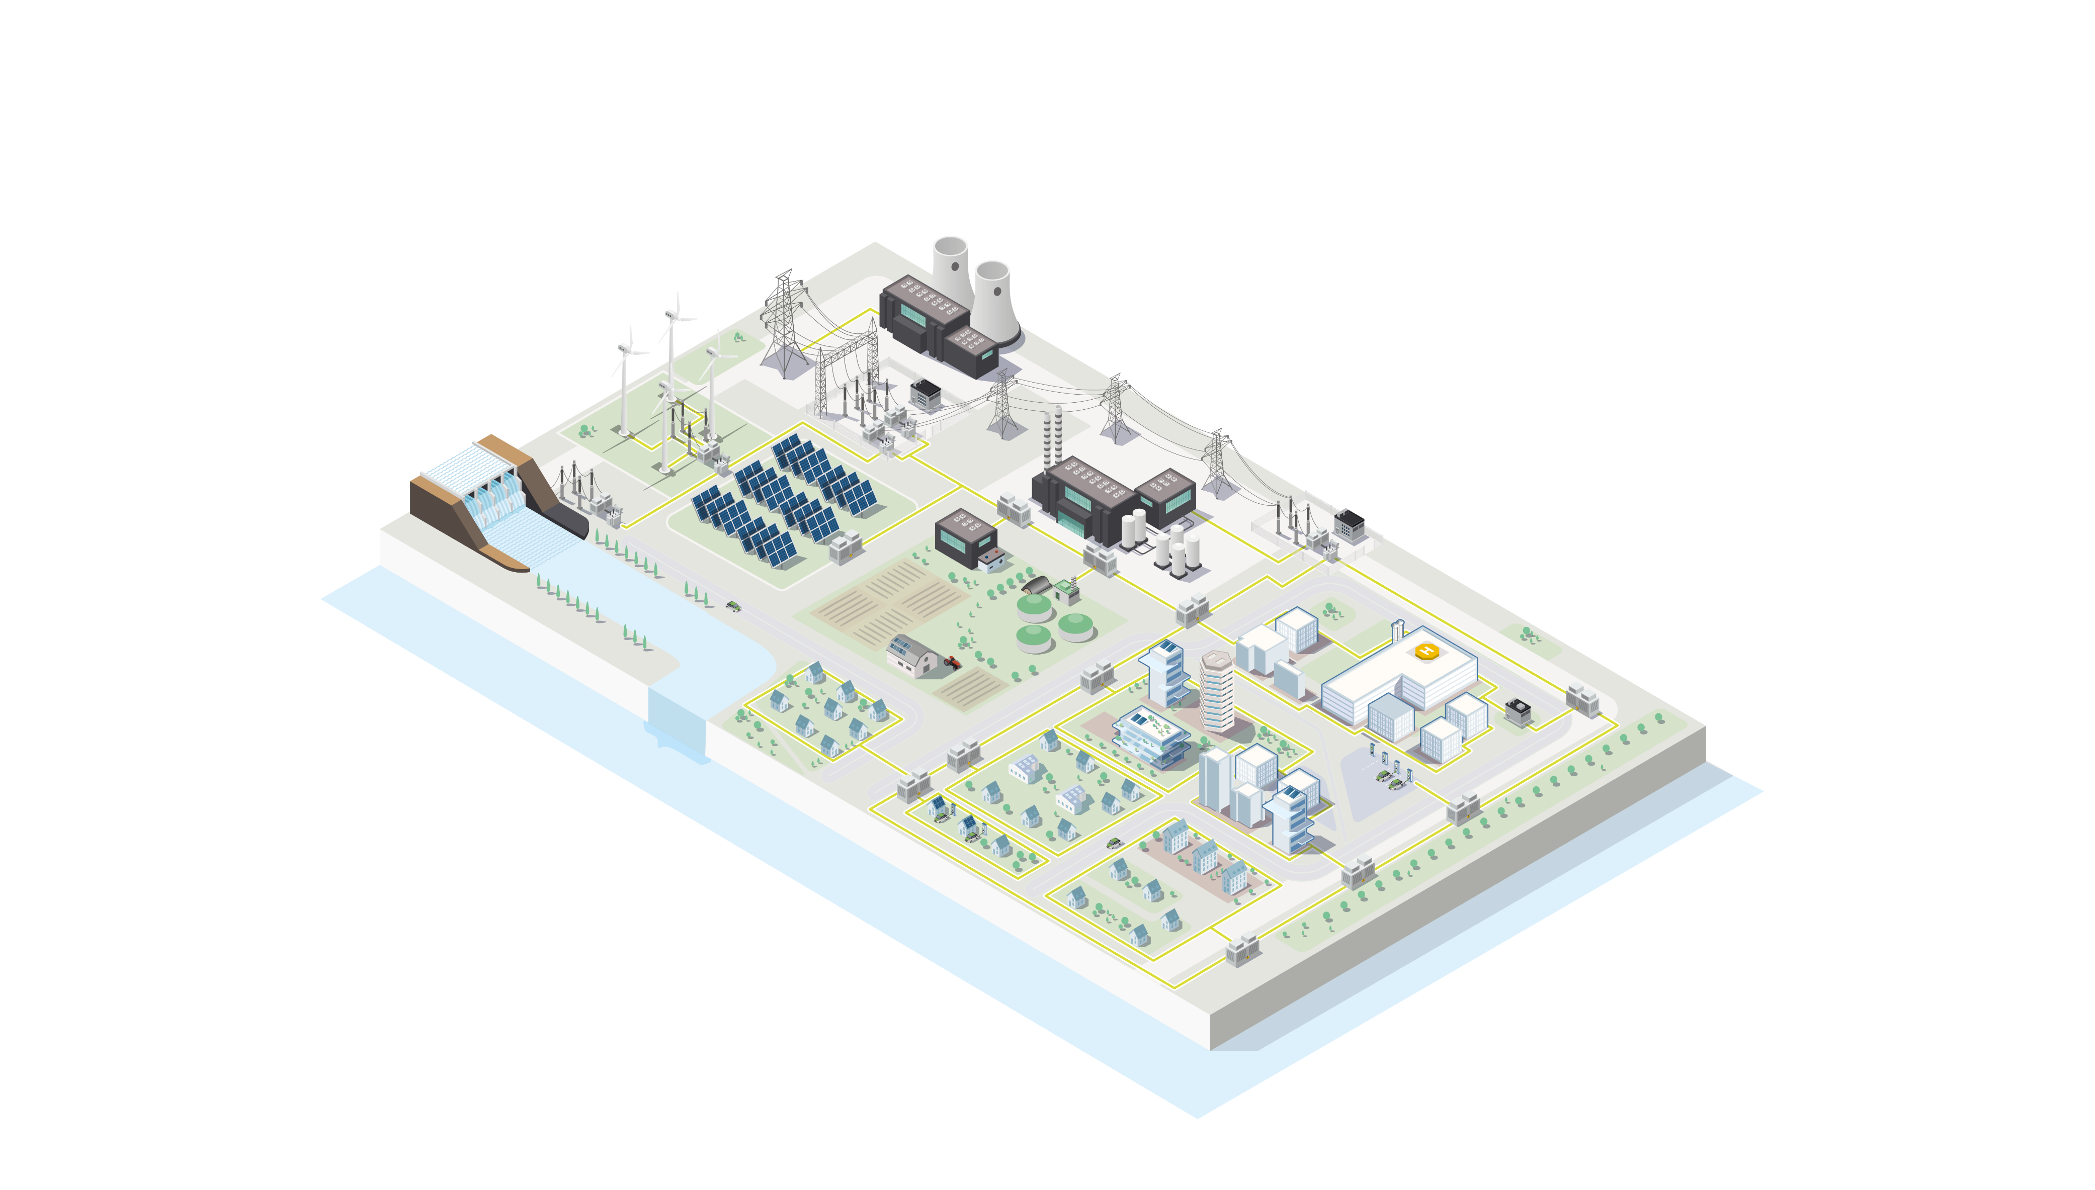

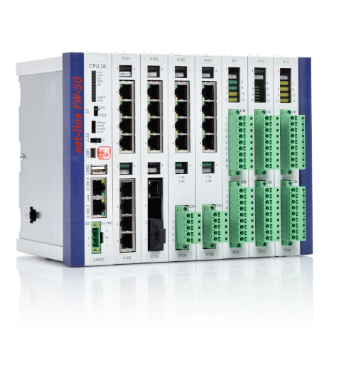
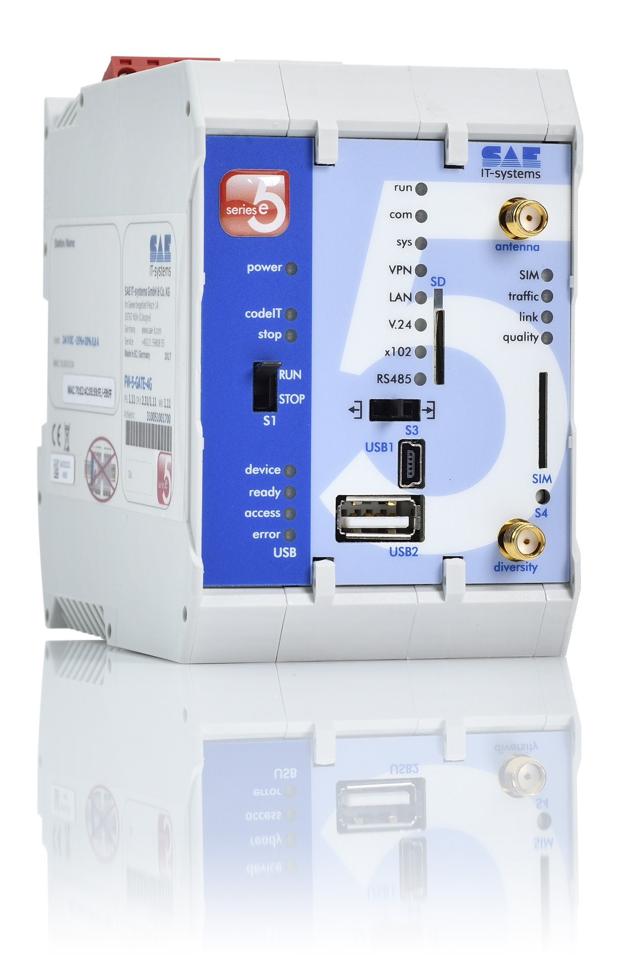
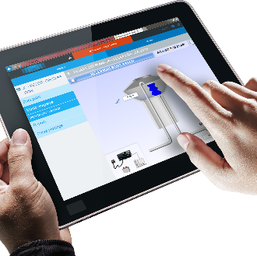
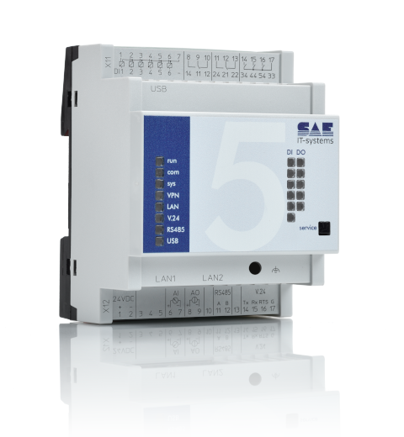

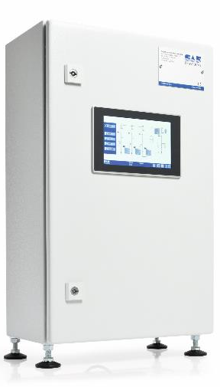
Smart Grids: Main use cases
Distribution
SCADA
Feed-In management of renewables
Substations
Secondary substations
Photovoltaic Field
Wind turbines
MV Customer Stations
Hydroelectric Power Plant
Prosumers
Biomass cogeneration
Battery storage
Consumer
Emergency Power Supply
(e.g. cogeneration)
Industrial Consumer
Residential urban areas incl. Photovoltaics, e-mobility and heat pumps
On site visualization
& control
This document is proprietary and confidential to LACROIX and may not be reproduced without prior authorization.
4

Slide 5
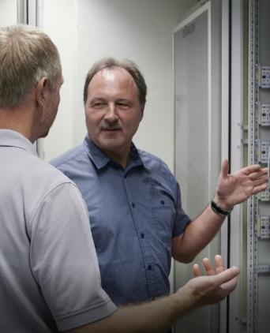
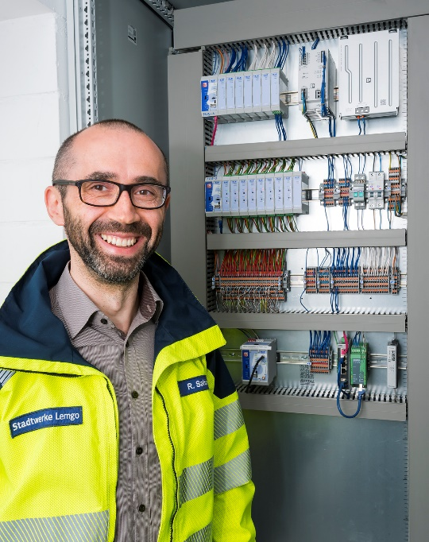
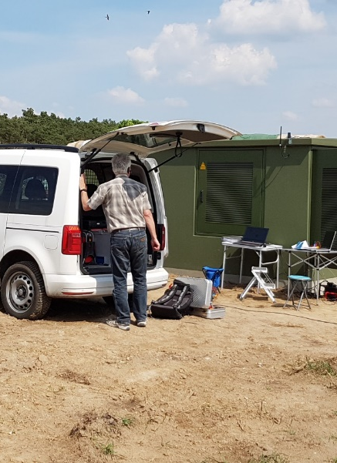
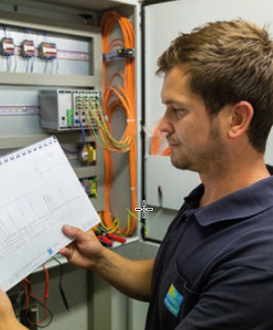
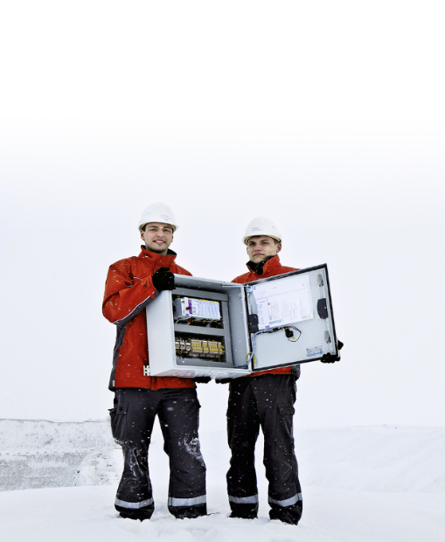
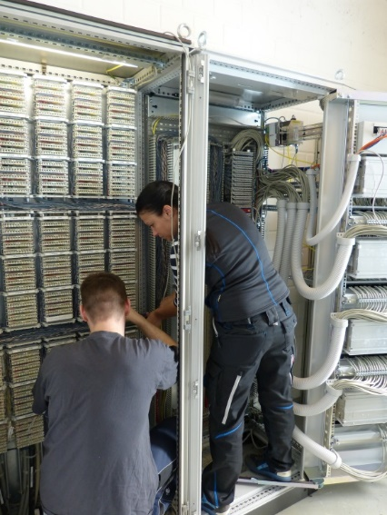










50 years of experience in designing and manufacturing solutions for telecontrol
More than 15.000
sites per year
More than 1.000
customers

Slide 6
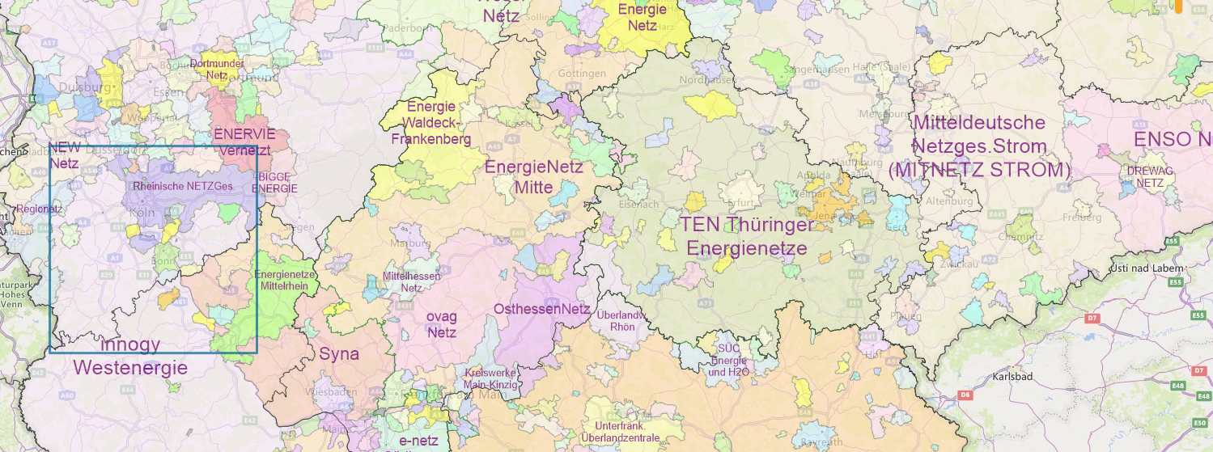
Same, same … but different
From our roots to your added value
900 utilities and DSOs
Manage the distribution grid in Germany
LACROIX helps
600 of them
to manage similar but not identical use cases

Slide 7




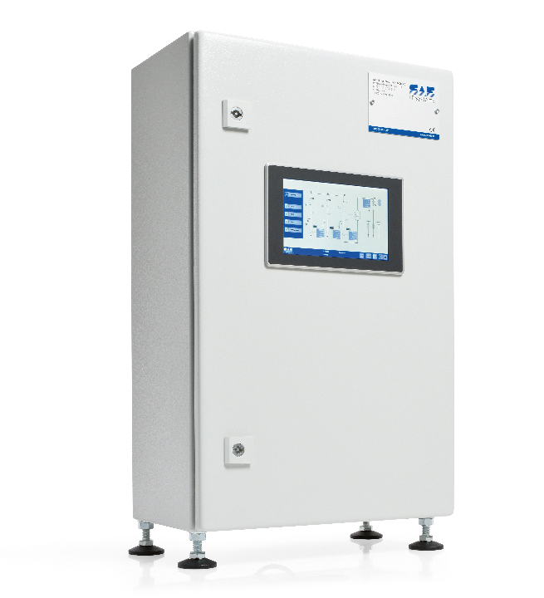
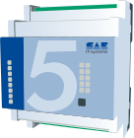
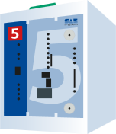
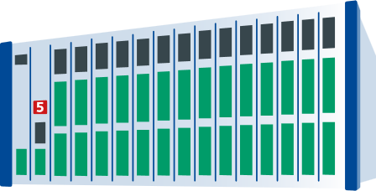
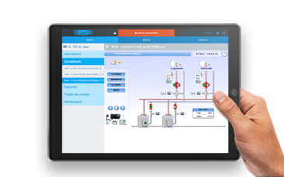



Smart Grids ecosystem:
from data acquisition to
their cyber-secured centralization
IoT
Scada
Cloud
Communication
4G
LTE-450
LTE-M
IEC 101
IEC 104
MQTT
NB-IoT
GPRS
3G
IEC 61850
DNP3
Acquisition
& Control
Radio
Ethernet
IEC 103
Modbus
3rd party devices
Visualisation
e.g. mobile
Sensors
Meters
This document is proprietary and confidential to LACROIX and may not be reproduced without prior authorization.
7

Slide 8
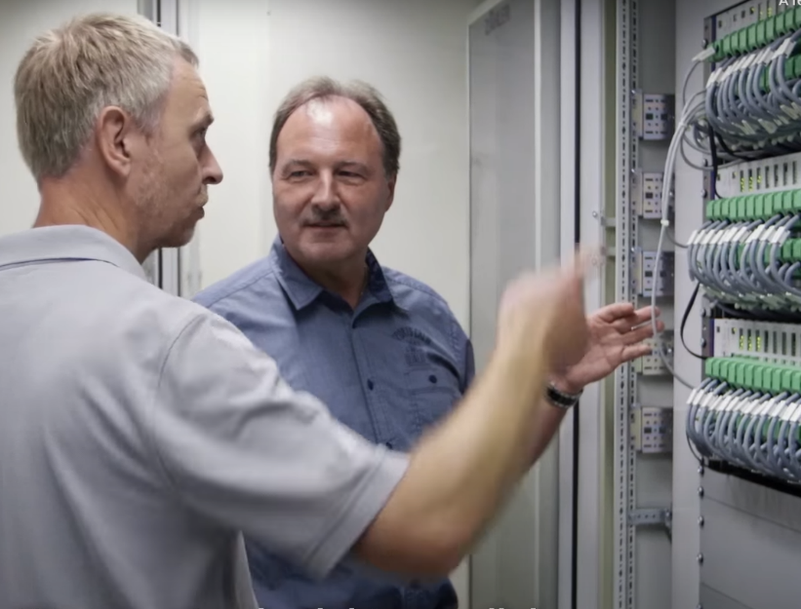
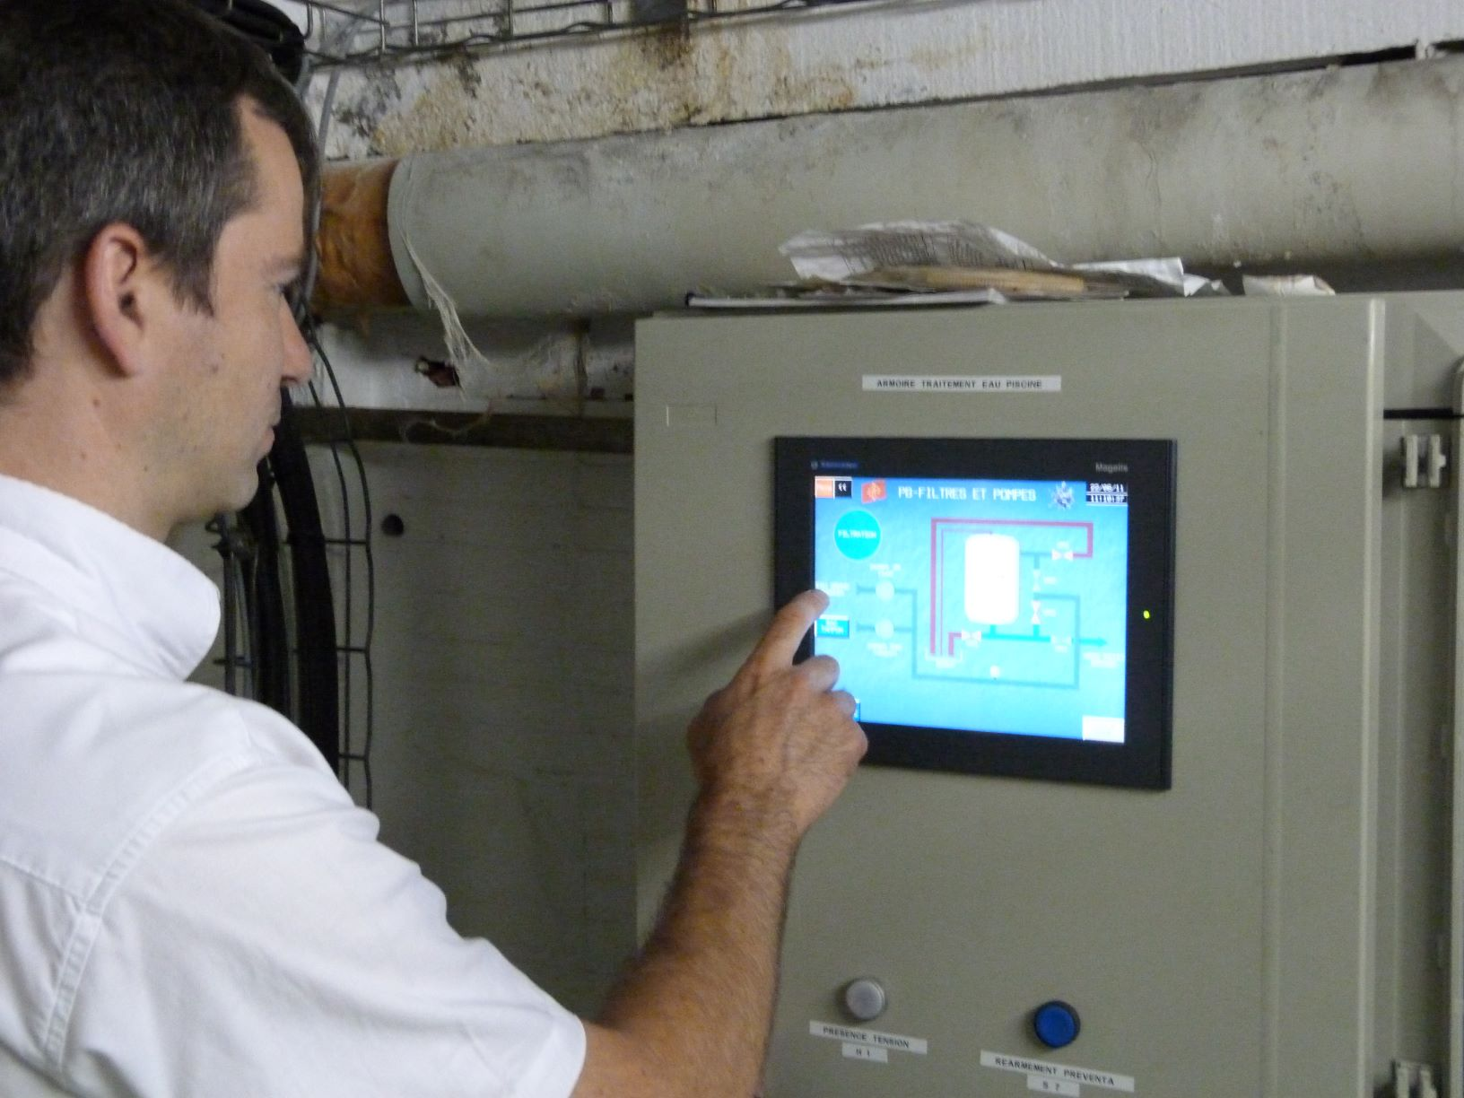
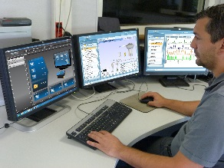
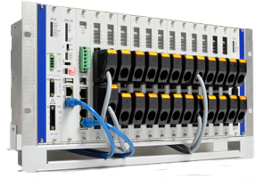

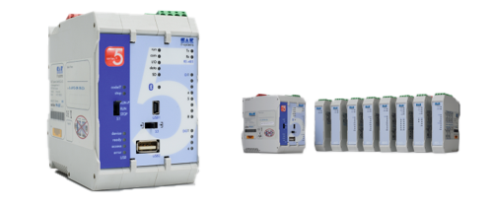
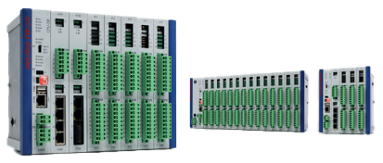


Smart Grids RTUs:
Product range
M5 & FW-5
BCU-50 & FW-50
Configuration and programming
Secondary substations
Substation automation
Diagnostic and patch management
Feed-In Management for renewables
Central RTU (concentrator)
Local visualization

Slide 9
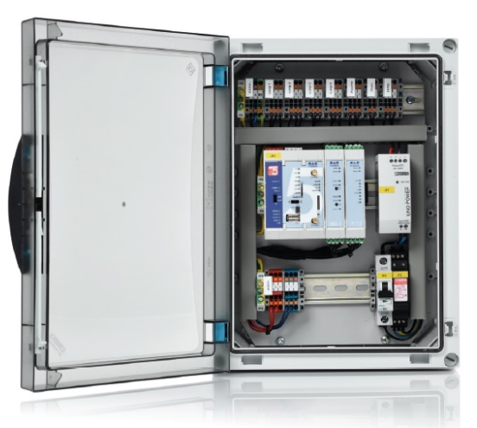
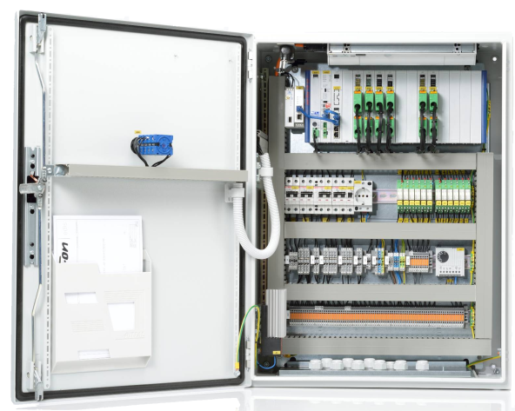
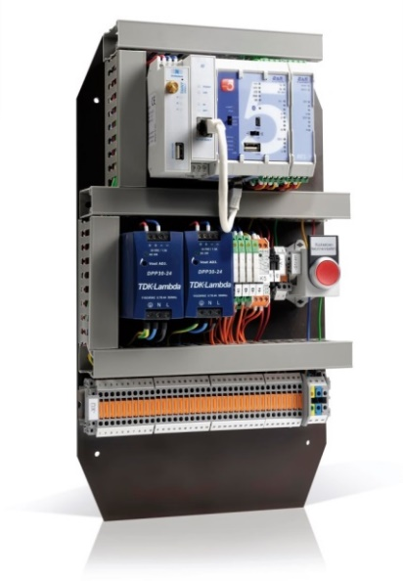
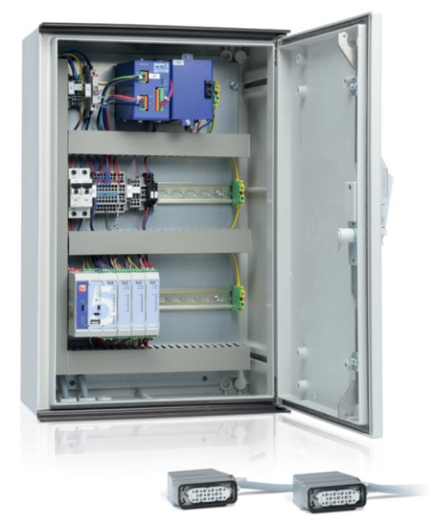

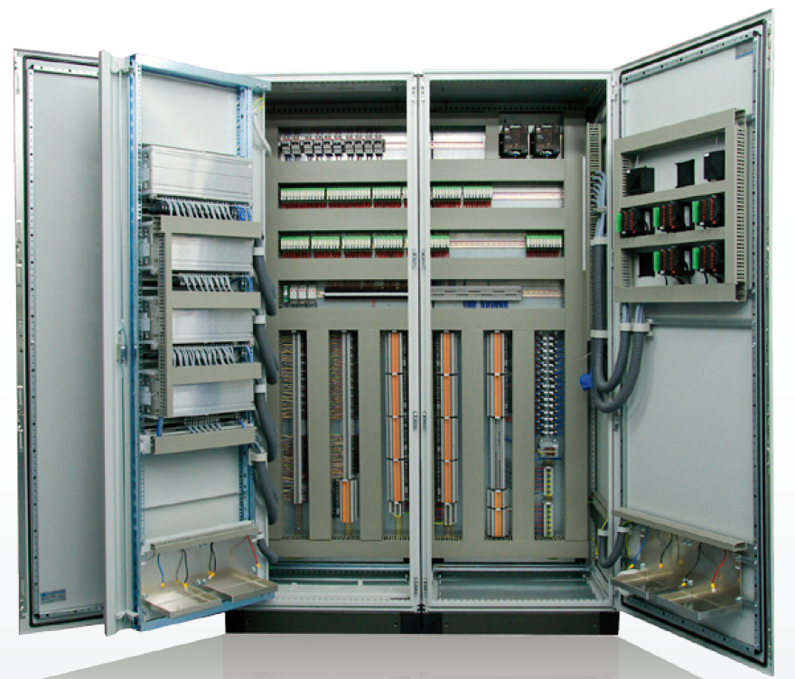
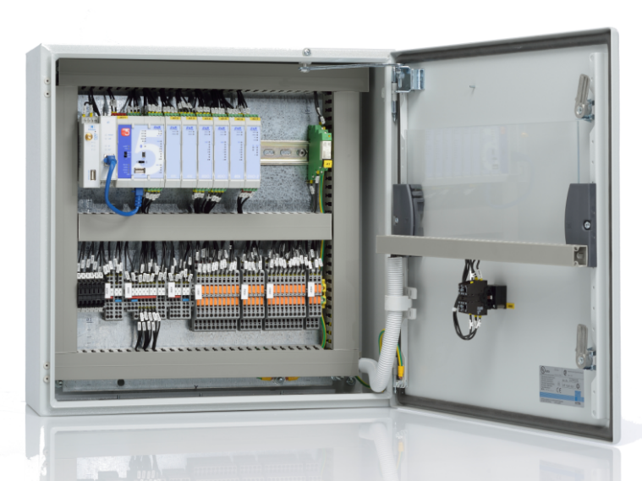
Components vs solutions
Individual products

Slide 10
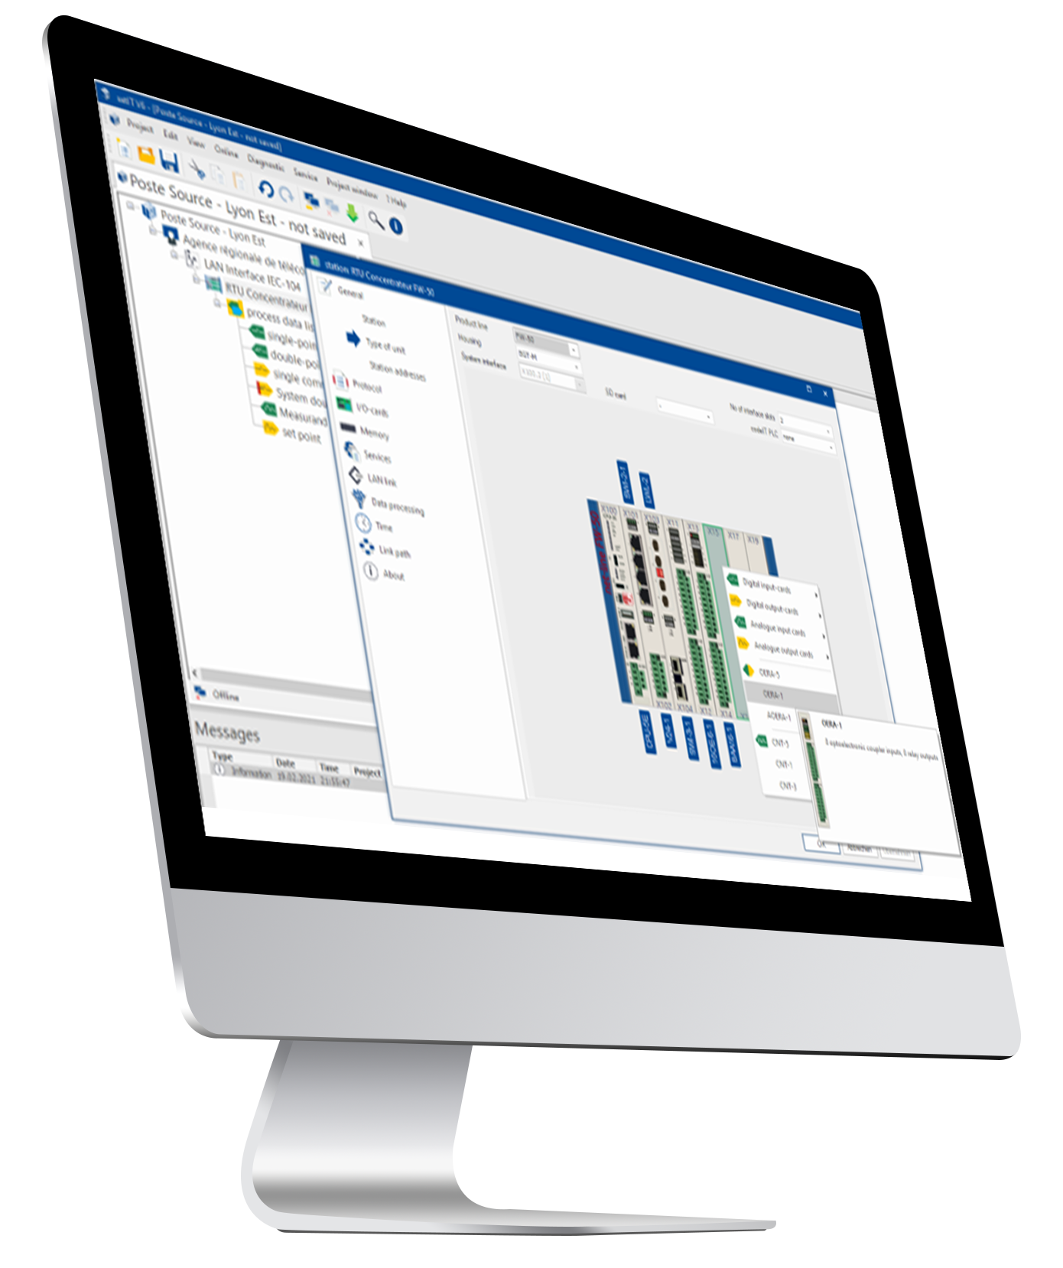

Set IT Software
Much more than a parametrizing tool
Set IT multilingual from version 7
PLC applications
Cybersecurity Management
Patch Management
Integrated support
Distance diagnostic or on site
Faster tool (e.g. Copy/Paste)
Simple Management of complexity
Intuitive guidance
Configuration,
programmation
and diagnostic
all in one
This document is proprietary and confidential to LACROIX and may not be reproduced without prior authorization.
10

Slide 11


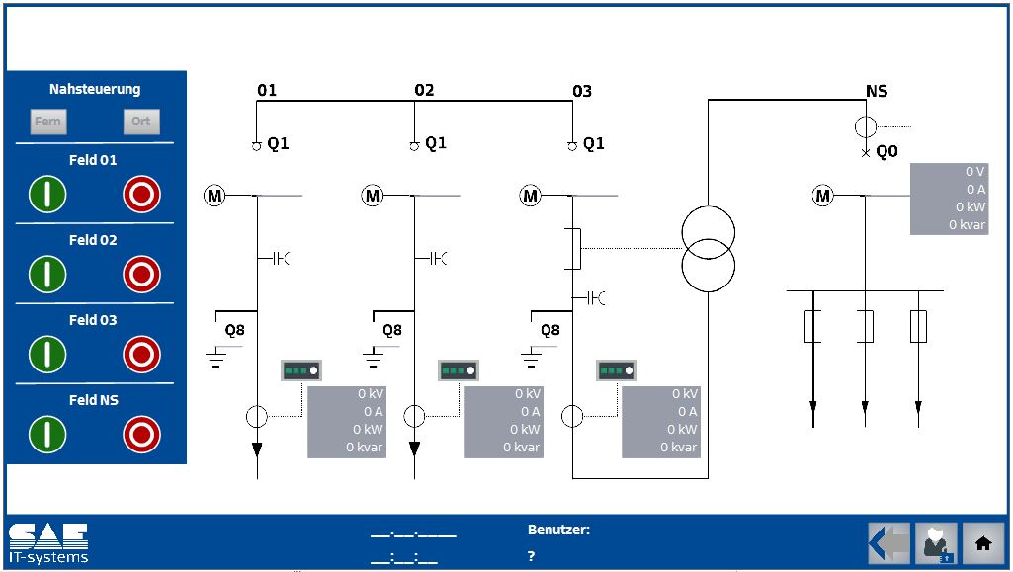
Vis IT
On site visualization and switching
This document is proprietary and confidential to LACROIX and may not be reproduced without prior authorization.
11

Slide 12
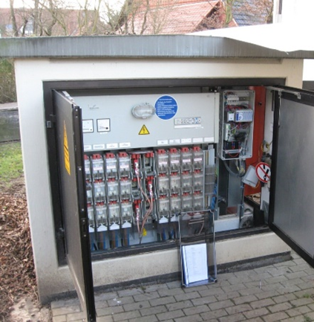
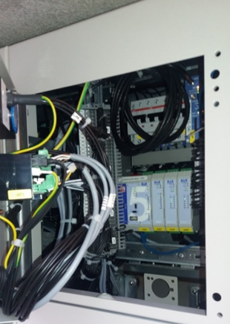
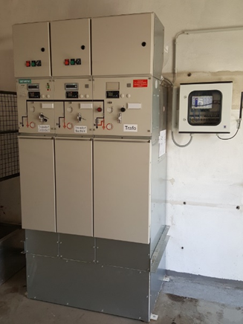
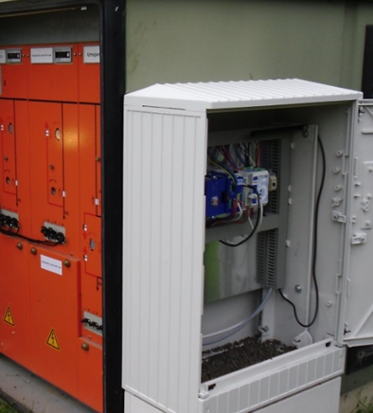

Living the modularity
New station VS retrofit - Big space VS tiny locations
This document is proprietary and confidential to LACROIX and may not be reproduced without prior authorization.
12

Slide 13

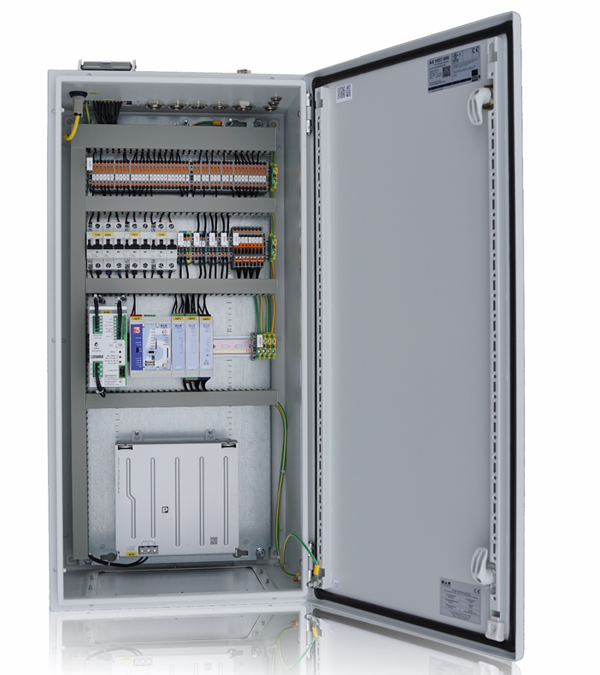
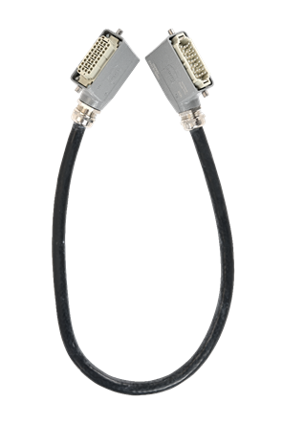
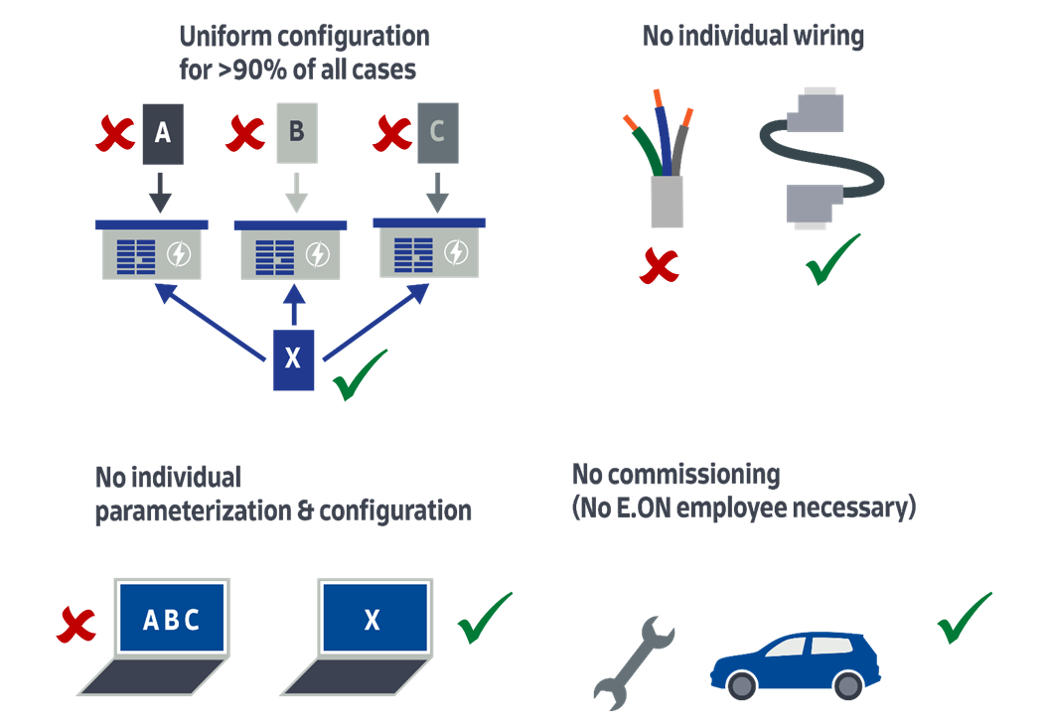
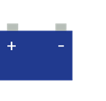
No fear from responsibilities
Harmonizing infrastructure
How we helped the biggest DSO Germany harmonize its infrastructure for secondary substations ?
Uniform configuration for >90% of all cases
No individual wiring
No individual parameterization & configuration
No commissioning (No E.ON employee necessary)
This document is proprietary and confidential to LACROIX and may not be reproduced without prior authorization.
13

Slide 14

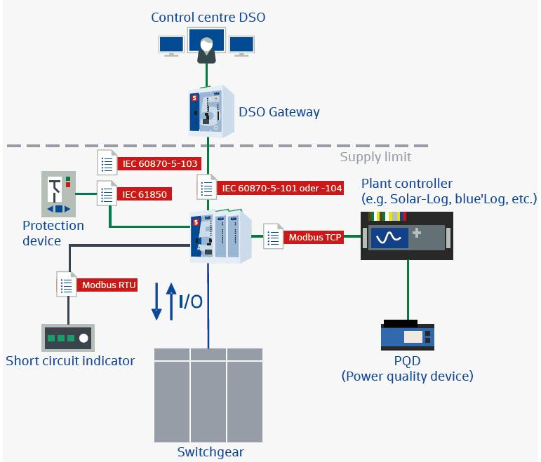
Feed-In Management
More than 10 years of
expertise
Thousands of renewable plants (>100kW) connected to DSO grids through our RTUs
> 50 different concepts
SAE RTUs are very often on DSO
& producer site
This document is proprietary and confidential to LACROIX and may not be reproduced without prior authorization.
14

Slide 15
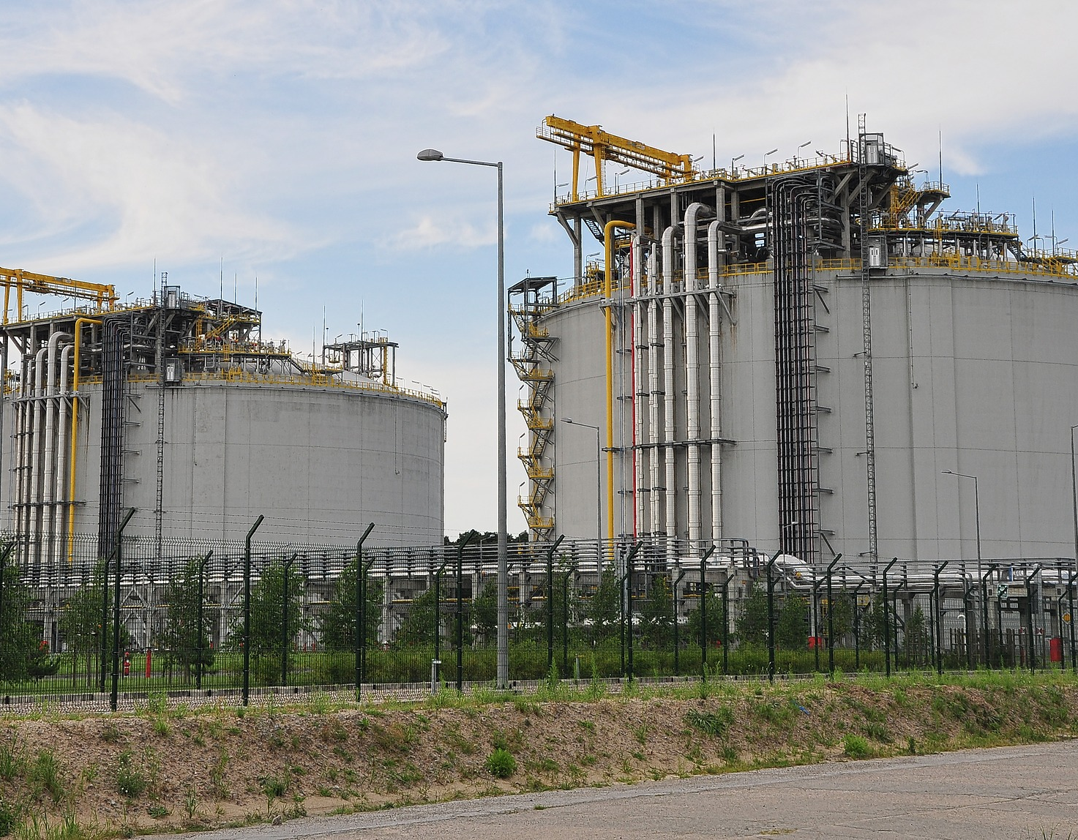
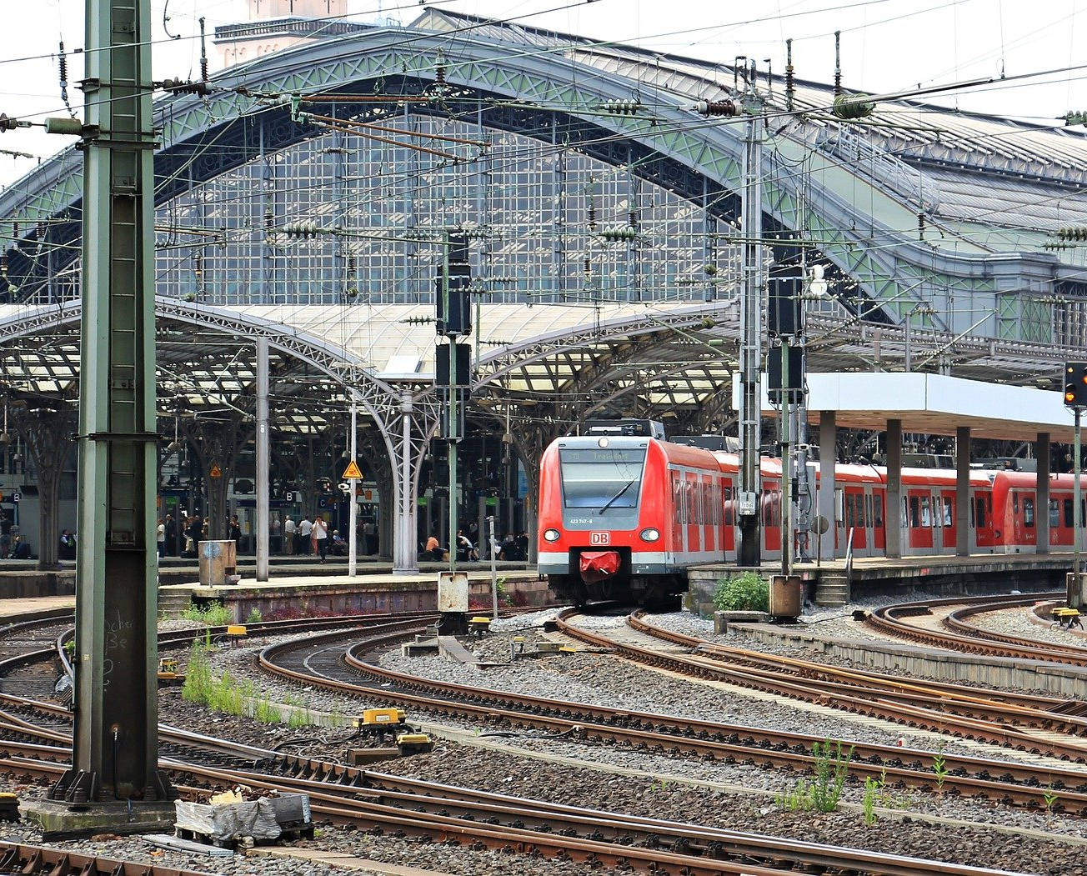

Smart Grid
What else?
RTUs for Gas
in pressure transformation substations
in central stations
RTUs for Railway
Transformations stations
No limits
Still unknown business models

Slide 16
Notes:
Questions from Vanessa
So what is your added value on this market?
Answer 1: 100% focussed big R&D Team and >45 years exp
Answer 2: the huge repertoire due to the very high number of german DSOs
Answer 3: the solution approach
In your international focus, which market drivers are you observing
Feed In Management
New ways of telecom
High focus on Cyber sec

