Slide 1
Overview on grid infrastructure and energetic smart grids incl. cyber security in the
German industry
Alexander Mutz

Slide 2

Personal Introduction
M. Sc. Alexander Mutz
Background:
Electrical Engineering and Information Technology
Expertise:
Ancillary services and flexibility measures
DC-Smart-Grids
Association:
EEP at University of Stuttgart
Fraunhofer IPA

Slide 3
1
EEP – A Research Hub for Industrial Energy Efficiency
2
The electrical grid in the face of challenges
3
Smart Grids in the future grid
4
Cyber Security

Slide 4
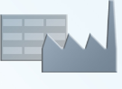





EEP – A Research Hub for Industrial Energy Efficiency
Industrial Research
Industrial microgrids and energy storage
Efficient, flexible and secure electrical
supply powered by renewable sources
Fraunhofer Institute for
Manufacturing Engineering
and Automation IPA
Graduate School of Excellence
advanced Manufacturing Engineering
Energy policy, strategy & finance
Survey of current developments and trends
in industrial energy efficiency in Germany
Integrated energy system planning
Conceptual design of industrial energy systems matched to requirements
Energy data analysis
Data-based optimization of energy systems to increase energy efficiency and flexibility
Industrial heating and cooling supply
Ensuring efficient and sustainable supply
of thermal energy for industrial processes
GREES
Graduate and Research school
Efficient use of Energy Stuttgart

Slide 5
1
EEP – A Research Hub for Industrial Energy Efficiency
2
The electrical grid in the face of challenges
3
Smart Grids in the future grid
4
Cyber Security

Slide 6
The electrical grid in the face of challenges
Challenges posed by changing energy generation composition
Romania has a large share of renewables, of which about 50% is Hydropower
Romania adds more and more volatile sources as has been happening in Germany.
Source: Eurostat

Slide 7
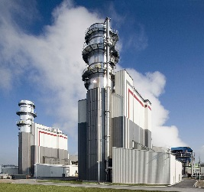
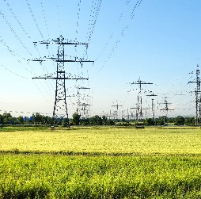

The electrical grid in the face of challenges
Challenges posed by changing energy generation composition
Generation
Volatile
Controllable
Fossil fuels
Energy
Information
Generation
Nuclear power
Distribution
Energy
Information
Present energy demand
Demand
Demand

Slide 8


The electrical grid in the face of challenges
Challenges posed by changing energy generation composition
There is a need for controllable energy consumption and storage capacities:
Volatile
Controllable
Fossil fuels
Renewable energies
Industry 4.0 – Balancing demand and generation by increasing information exchange
Generation
Nuclear power
Storage systems
Energy storages allow to decouple energy demand and generation
Present energy demand
Flexible energy demand
Demand
Industrial stakeholders must play a more active role in future energy systems
Notes:
Übertragungs- und Verteilnetze
Gezielte, wirksame Modernisierungsmaßnahmen durch regelmäßiges Monitoring
Digitalisierung und Resilienz von Stromnetzen fördern
Stärkere Durchdringung der Netze mit Sensorik und Aktorik
Fokus auf Erweiterungs- statt Ersatzinvestitionen
Transparenz in den Stromnetzen durch mehr Sensorik verbessern
Leistung statt Energie bepreisen
Digitaler Netzanschluss
Schnell gesetzliche Grundlage für das Steuern von potenziell flexiblen Verbrauchern schaffen
Rollout der Smart-Meter-Gateway unverzüglich beschleunigen
Zielbild Netzintegration umsetzen
Intelligente Einbindung der Wallboxen bei ihrer Förderung mitdenken
Incentivierung von gesteuertem bidirektionalem Laden fördern
Umlagefähige Investitionen für Verteilnetzbetreiber am digitalen Netzanschluss
Sichere Stromversorgung, Speicher und Wasserstoff
Ausbau von Speicherkapazitäten beschleunigen
Verlässliche Rahmenbedingungen für Speicher schaffen
Wasserstoff-Netzwerk konsequent ausbauen
Zurück zur Übersicht

Slide 9
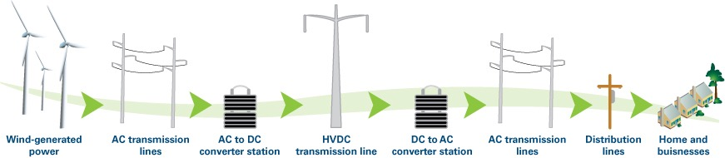
The electrical grid in the face of challenges
Changes in the electrical grids
A shift from purely AC – Distribution, transmission and industrial grids to DC or hybrid grids is taking place.
DC offers several advantages in the integration of renewables and energy efficiency
Source: Texas Instruments

Slide 10
1
EEP – A Research Hub for Industrial Energy Efficiency
2
The electrical grid in the face of challenges
3
Smart Grids in the future grid
4
Cyber Security

Slide 11
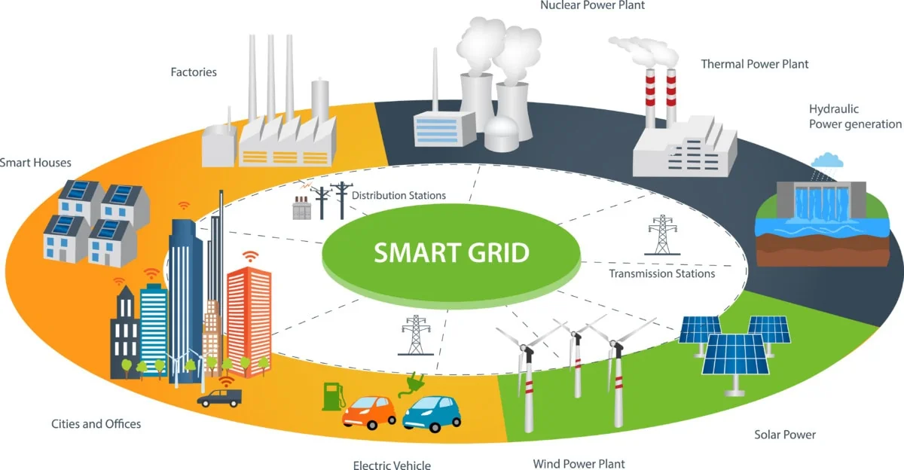
Smart Grids in the future grid
What is a Smart Grid?
The concept of a smart grid involves:
Various decentral units of energy generation, consumption and storage
Multidirectional power flows between the components of the grid
Energy management with controllable decentralized energy units
High grade of active information exchange between the components of the grid
All grid participants must provide ancillary services to the grid
Source: energieloesung

Slide 12
Smart Grids in the future grid
What is a Smart Grid?
Generation
The objective of the Smart Grid is:
To coordinate the needs and capabilities of all generators, grid operators, end-users and electricity market stakeholders
To minimize costs and environmental impacts
To maximize system reliability, resilience and stability
Distribution
Demand
Storage
A Smart Grid operates all parts of the system
as efficiently as possible
Energy & Information

Slide 13
Smart Grids in the future grid
Data collection, IoT and Control
Collect
Transmit
Calculate
Take Action
IoT Systems can offer the necessary data to take actions
Realtime communication allows the smart grid to be in ist optimal state
Powerful prediction software can predict faults and demand surges.
Notes:
through for example smart meters or other sensor and IoT solutions

Slide 14
Smart Grids in the future grid
Regulatory actions and policy changes in Germany
Smart Meter Rollout:
Started in 2020 and aims for 100% residential coverage until 2032
Factors driving Smart Grid deployment
Ancillary services markets:
Markets for participants to provide grid stability services
Energy source phase-outs:
Nuclear phase-out completed in 2023, Coal phase-out in 2038
Time dependent energy pricing:
Base- and peak-load pricing on the Future Market
Liberated electricity market:
First liberalization law passed as early as 1998
Source: BSI, BMWi, Federal Government, BASE, EEX

Slide 15
1
EEP – A Research Hub for Industrial Energy Efficiency
2
The electrical grid in the face of challenges
3
Smart Grids in the future grid
4
Cyber Security

Slide 16
Cyber Security
Why does it matter?
The aim of Cyber attacks is to
take control of the system, of the data and/or
harm/damage/incapacitate the physical equipment.
Thus, in the case of the smart integrated energy systems, the goal is to take control of the energy system so that energy cannot be produced, transmitted, distributed, and/or used as intended. Our systems become smarter, they must not become more vulnerable.
Blackout/ Fallout
unavailable services
damage

Slide 17
Cyber Security
What actions to take
Prevent attacks
on users
on devices
Mitgate the impact
build redundancies
reduce interconnection
shut down problematic devices
Recover systems
Turn on redundant systems
Prevent further attacks
Energy is critical infrastructure → Protection is of the essence.
The implementation of security protocols, surveillance systems and emergency plans becomes necessary
Challenges are:
  Increasead area of attack
  Protection from attacks
  Ensuring data integrity and confidentiality
Notes:
In general, the aim of cyberattacks is to take control of the system, of the data and/or harm/damage/incapacitate the physical equipment. Thus, in the case of the smart integrated energy systems, the goal is to take control of the energy system so that energy cannot be produced, transmitted, distributed, and/or used as intended.
Why is it important: → Fallout of critical energy infrastructure leads to panic buying and or panic reactions by the public and further economic damages for the supplier and the users.
Goals: Prevent, mitigate, recover
Attackable components: Servers, Networks, Websites, Mobile Applications, Software and firmware, Webservices, Cloud based platforms, sensors and actors, other hardware, Users
Statistik: Cyber Angriffe Deutschland
Directive on measures for a high common level of cybersecurity across the Union (NIS2 Directive)
NIS2 Driective labels energy as sector of high criticality and hence as essential to protect in a cyber security sense.

Slide 18

Thank you!
Alexander Mutz
Research Associate
+49 711 970 – 1914
alexander.mutz@eep.uni-stuttgart.de​
​
17. September 2024

Slide 19
Sources
Eurostat: https://ec.europa.eu/eurostat/databrowser/view/nrg_ind_ren/default/table?lang=en&category=nrg.nrg_quant.nrg_quanta.nrg_ind_share
Pipeline Cyber attacks, UNECE, Task Force on Digitalization in Energy: https://unece.org/sites/default/files/2023-12/Pipeline_Cyberattack_case.study_.2023_rev.2_0.pdf
Energieloesung
https://www.energieloesung.de/magazin/was-ist-ein-smart-grid-und-was-bedeutet-er-fur-die-elektromobilitat/
Bolstering the electricity grid: A priority to achieve Romania’s 2030 decarbonisation objectives, Andrei Covatariu, 06.2024 https://www.enpg.ro/wp-content/uploads/2024/06/EPG_Bolstering-the-electricity-grid_A-priority-to-achieve-ROs-2030-decarbonisation-objectives.pdf
Texas Instruments https://e2e.ti.com/cfs-file/__key/communityserver-blogs-components-weblogfiles/00-00-00-09-70/2627.Transmission-Process.jpg
BSI
https://www.bsi.bund.de/DE/Themen/Verbraucherinnen-und-Verbraucher/Informationen-und-Empfehlungen/Internet-der-Dinge-Smart-leben/Smart-Meter-Gateway/Smart-Meter-Gateway-FAQ/smart-meter-gateway-faq_node.html
BMWi
https://www.bmwi.de/Redaktion/DE/Publikationen/Energie/achter-monitoring-bericht-energie-der-zukunft.pdf?__blob=publicationFile&v=32
Federal Gevernment
https://www.bundesregierung.de/breg-de/themen/klimaschutz/kohleausstieg-1664496
EEX
https://www.eex.com/de/maerkte/strom-terminmarkt/strom-futures
BASE
https://www.base.bund.de/DE/themen/kt/ausstieg-atomkraft/ausstieg_node.html

