Slide 1


Infrastructure development for renewable energy, storage, and electrification in Romania
Mihnea Cătuți, Head of Research, Energy Policy Group (EPG)
Presentation for AHK event
17 September 2024

Slide 2
The energy transition will entail significant shifts across various economic sectors, impacting both supply and demand, and driving widespread changes
Romania is in the process of adopting a new National Energy Strategy and a revised National Energy and Climate Plan
Titlul prezentării, data
132%
50 GW
Increase in electricity production by 2050
Additional wind and solar power generation by 2050
[Uz intern – se poate omite, în funcție de nevoie]
În parteneriat cu: [zonă de pus logo parteneri]

Slide 3
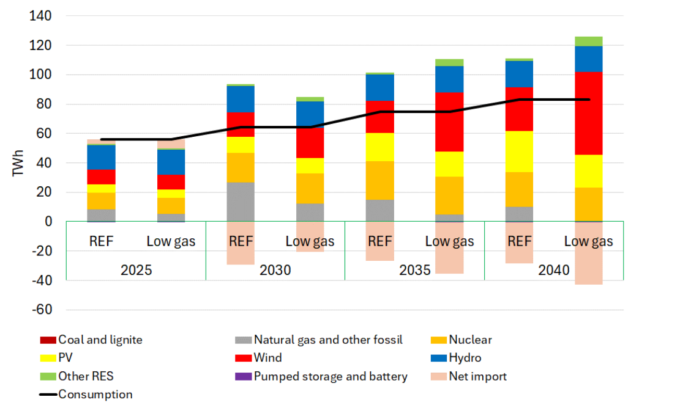
Installed capacities in Romania (GW) according to the Draft Energy Strategy
Romania’s electricity consumption is projected to grow by about 38% till 2030 and double by 2050
The increase will be driven by the electrification of several economic sectors. The adoption of heat pumps, along with a steady rise in the number of electric vehicles (EVs) are the main contributors. Industrial electrification and renewable hydrogen production are also expected to expand.
Romania can reach a completely decarbonised electricity production mix in 2040 with no security of supply risks by focusing more on wind power and a higher deployment of storage technologies (3.5 GW by 2040) based on REKK and EPG assessment.
Source: Draft Energy Strategy (2024)
Electricity mix in two decarbonisation scenarios by REKK and EPG
În parteneriat cu: [zonă de pus logo parteneri]
Source: REKK and EPG – Modelling of the Romanian Electricity Sector

Slide 4
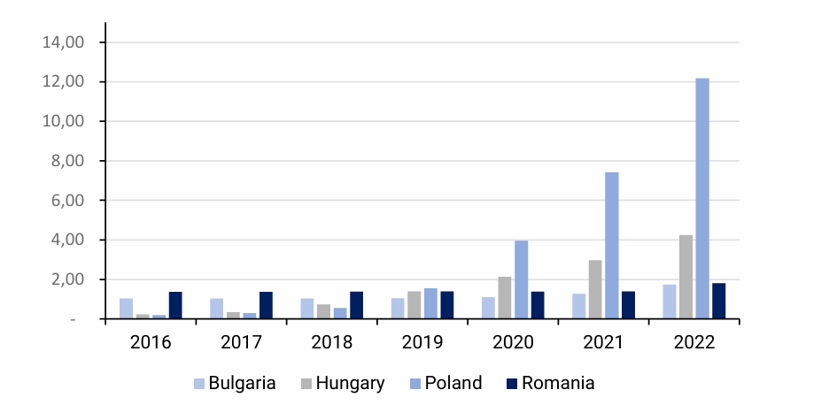
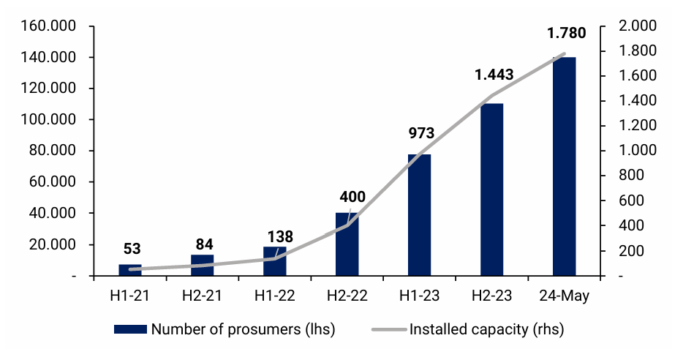
Solar energy is crucial for Romania’s decarbonisation goals
Romania, with 1.8 GW of installed PV capacity in 2022, has experienced limited growth compared to countries like Hungary (4.2 GW) and Poland (12.2 GW).
Legislative unpredictability, delays in the approving connection to the grid, and other bureaucratic hurdles constrained solar energy deployment in RO, with most of the capacity added between 2010 and 2016, driven by the green certificate support scheme.
The recent Energy Strategy outlines Romania’s commitment to expanding solar capacity, targeting 8.2 GW by 2030, 21.1 GW by 2040, and 33.3 GW by 2050.
Evolution of solar production capacities in Romania, Bulgaria, Hungary and Poland countries (GW, 2016 - 2022)
Evolution of the number of prosumers and installed capacities (MW, 2021 - 2024)
Source: Eurostat
Source: ANRE

Slide 5
Urgent investments are needed in the transport and distribution grids
Estimated investment needs in the Romanian electricity distribution grid amount to €9.2 - 11.5bn until 2030
Method 1. Estimated investment needs at €9.2bn by 2030, i.e. about €0.8bn/year (11 years); investment gap of €2.5bn
Method 2. Estimated investment needs at €11.5bn by 2030, i.e. about €1.05bn/year (11 years); investment gap of €4.8bn
Investment gap
~2,500
Investment gap
~4,800
Existing sources
~6,700
Existing sources
~6,700
Source: EPG estimations

Slide 6
The estimated investment for implementing heat pumps for residential applications is also significant
Estimated investment in heat pumps for residential applications (bln EUR)
Four types of heat pumps:
Air/air
Air/water
Ground/water
Water/water
Six types of homes:
individual home x 3 types of thermal insulation
Condominium x 3 types of thermal insulation
Three types of installation:
Heat pump
Heat pump + on-grid PV
Heat pump + PV - batteries
Four adoption scenarios:
500 000 homes
700 000 homes
900 000 homes
1 100 000 homes

Slide 7
Concluding remarks
Romania’s decarbonisation targets can be more ambitious by expanding RES capacities and gradually phasing down fossil fuel use.
Decarbonisation requires significant expansion of PV and wind power, which need an additional of at least 10 GW installed capacity to meet 2030 requirements, despite the value chain remaining largely outside Romania's borders.
The Modernisation Fund and NRRP are crucial public financing mechanisms supporting this effort. Additionally, the Contracts for Difference scheme represent key opportunity to ensure a predictable, long term revenue stream for investors.
In the medium term, Romania needs to install 1.2 GW of additional battery storage to meet 2030 requirements.
Romania will need to expand its grid capabilities and improve digitalisation to cope with increasingly intermittent and decentralised generation.
Heat pump roll out needs to accelerate massively, despite limited supply chain development at national level.

Slide 8
Thank you!
www.enpg.ro

