Slide 1
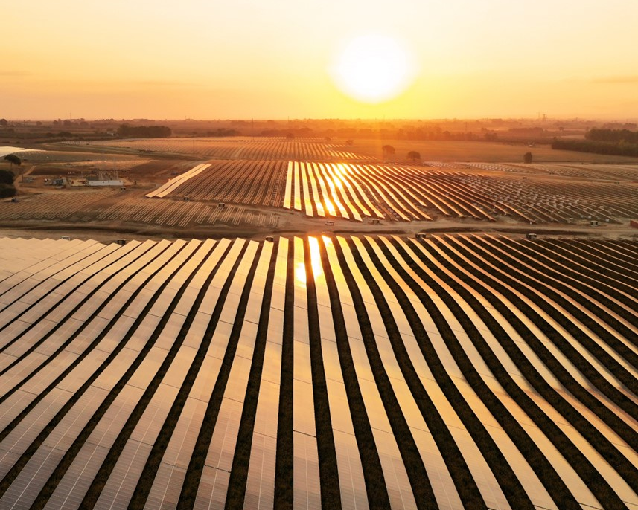
BayWa r.e. in Romania:
Harnessing Expertise
Anamaria Acristini, Managing Director | BayWa r.e. Romania SRL
Green Energy Conference, Bucharest

Slide 2
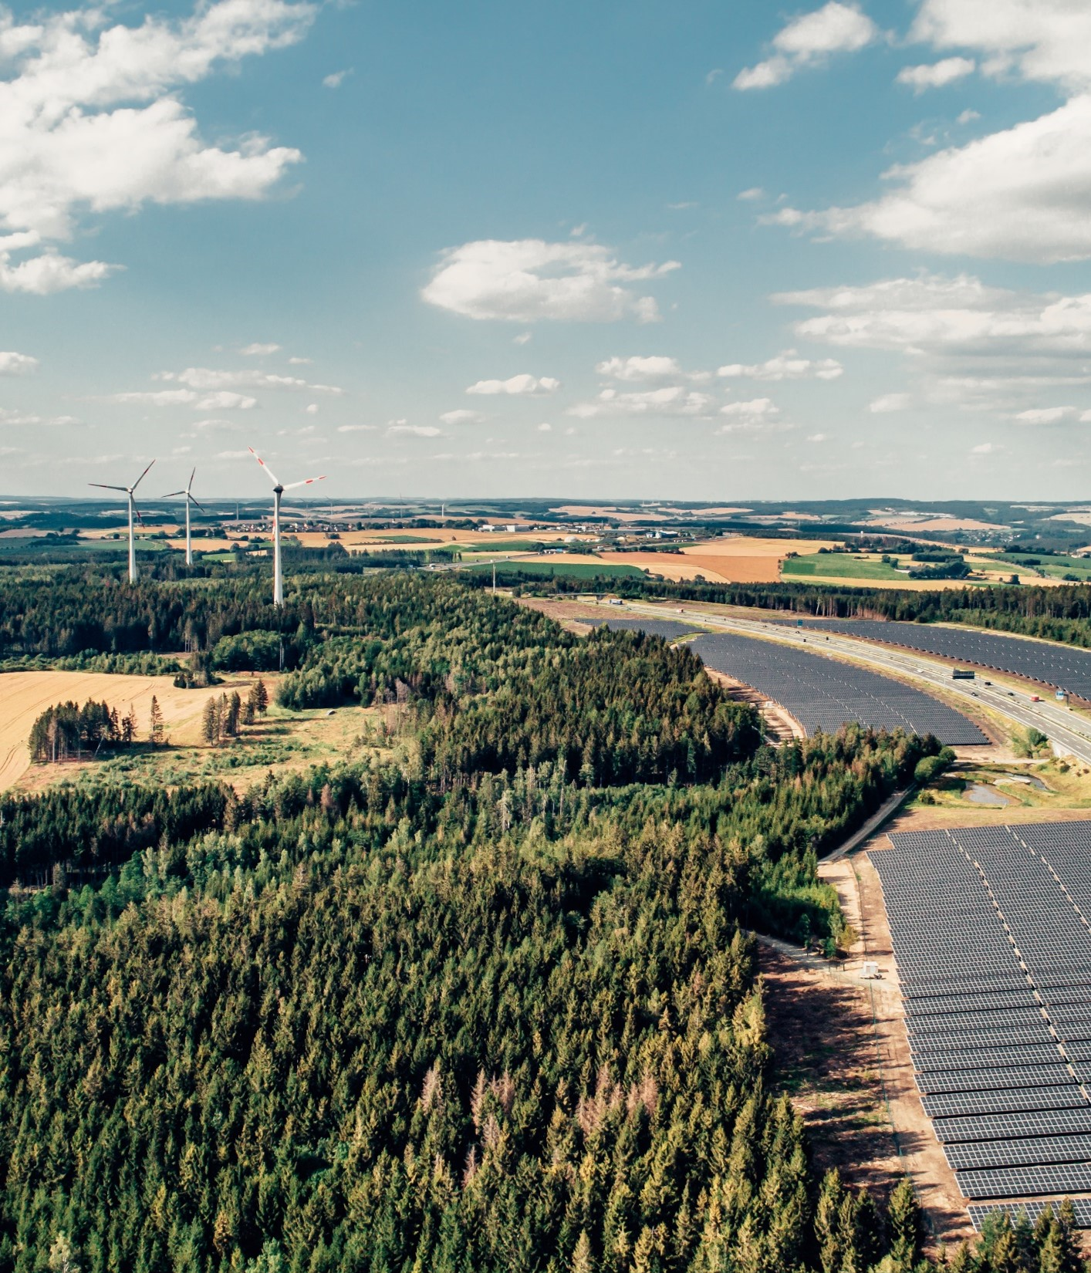


BayWa r.e. Facts and Figures
BayWa r.e. is a leading global renewable energy developer, service provider, distributor, and energy solutions provider.
Founded
2009
  Turnover 2023
        EBIT 2023
5.8bn €
193.8M €
  Employees
          Globally active
> 5,400
34
countries

Slide 3
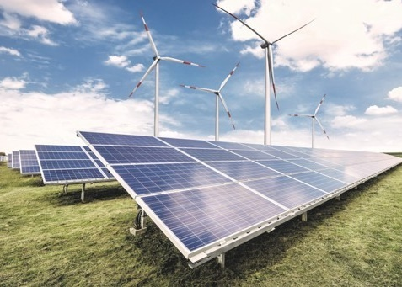

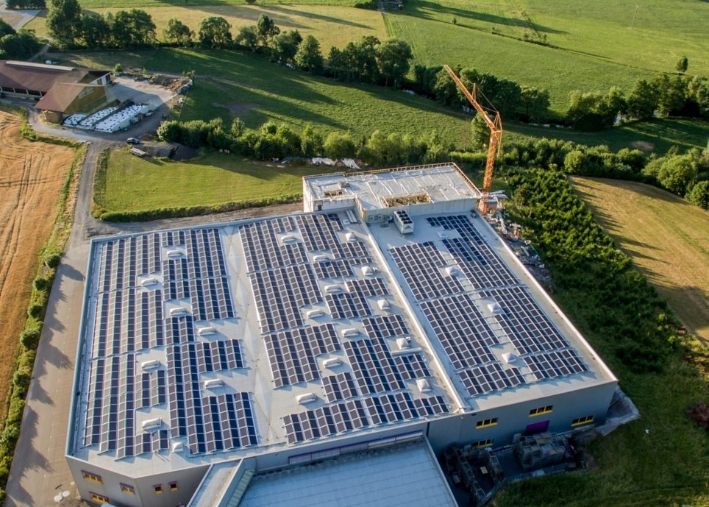
Our portfolio covers a broad range of renewable energies
Projects
Operations
Solutions
>5.8 GW installed capacity in wind and solar globally.
28.65 GW global project pipeline solar and wind including new technologies (hybrid projects, storage and green hydrogen).
10.7 GW under operational management; services in energy trading; consultancy and technical management for wind and solar energy.
6.8 GW direct marketing portfolio.
New IPP portfolio; plans to ramp up to
2.5 GW in the medium term.
30 years of solar distribution experience, a wide range of quality products and services for about ~ 17,000 installation and sales partners globally.
Tailor-made Energy Solutions for commercial and industrial clients
from self-consumption to green energy supply.

Slide 4
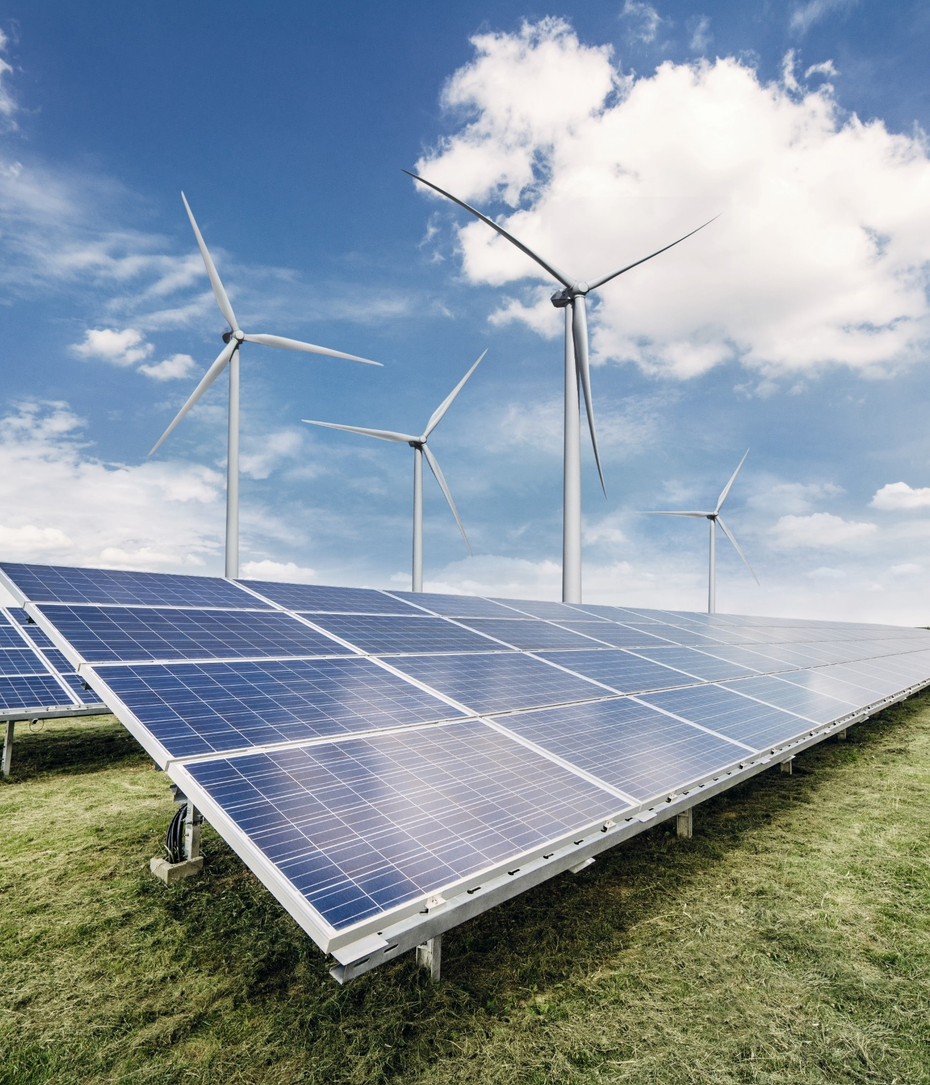








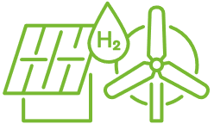
Driving forward the renewable transition with more than 30 years of experience in project business globally
Project development, turnkey construction, financing
Offshore wind,
bottom fixed and floating
Optimisation and repowering
Floating PV,
floating solar farms on water
PROJECTS
Long-term
operations
Agri PV,
joint use of agricultural land
Community investment options with tailor-made development and cooperation models
Hybrid farms, combining
solar and wind, battery storage, green hydrogen
Notes:
Our business model focuses on sale at RTB with EPC commitments. We leverage over 30 years of experience in the wind and solar energy sectors, with our expertise ranging from traditional projects to innovative solutions such as agri-PV, floating-PV, and offshore wind.

Slide 5

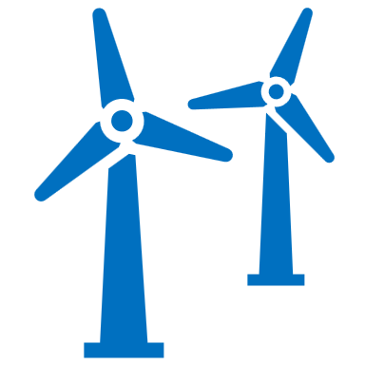
BayWa r.e. in Romania
Established in
Total employees
Total pipeline
2022
10
>1 GW
    Romanian market entry made in 2021
    Local establishment of BayWa r.e. Romania S.R.L since 2022, with offices in Bucharest and Sibiu
    First large-scale project execution planned for 2025
    Priority to deliver production to corporate and industrial off-takers through PPAs

Slide 6
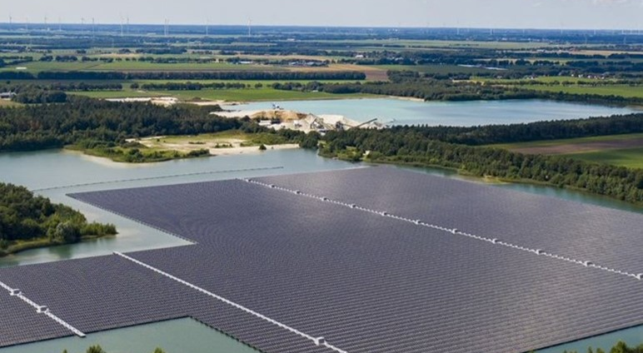
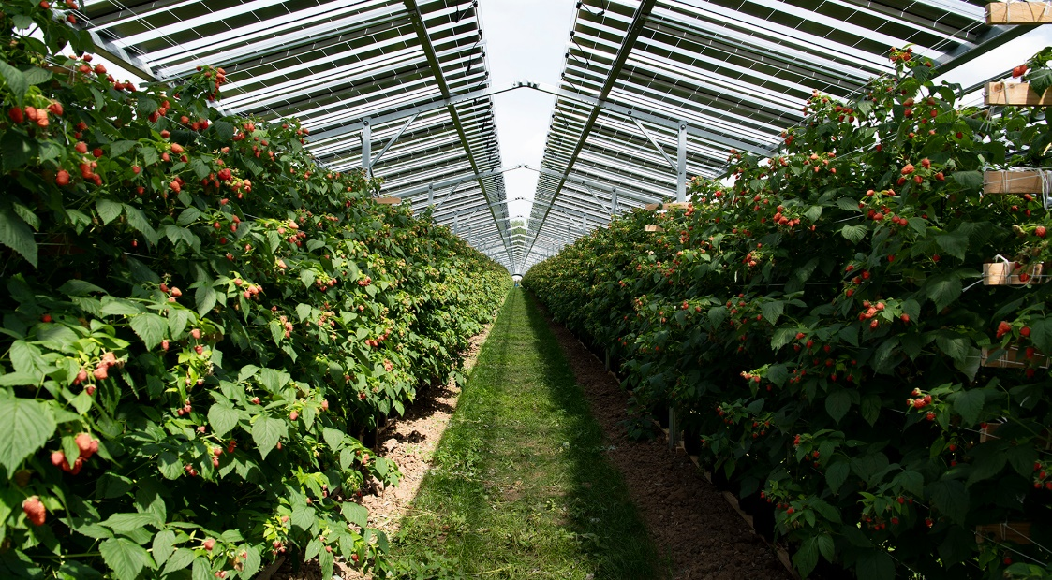
Reliable partner for developing solar parks, focusing on quality and taking our work to the next level with Floating-PV and Agri-PV
We are a market leader in Floating-PV in Europe, with over 2GWp Floating-PV pipeline. Our patented floating transformer station guarantees highest electrical efficiency for highest yields.
Agriculture is woven into our DNA through our parent company, BayWa AG. Having already developed over 1,2 GWp of Agri-PV projects, our mission is to implement the almost inexhaustible potential of Agri-PV worldwide.
Notes:
Why floating-PV?
No use of agricultural land, avoidance of land use conflict​ and little site preparation/vegetation removal needed for construction
East-West configuration allows a more compact system, ​more power per area (up to 2 MWp/ha) and lower cable losses
Very fast construction of the plant (up to 5MWp/week)
Why agri-PV?
Easier permitting and improved grid access as land use efficiency is increased
Farming participating in energy transition results in increasing and diversifying income of farmers, therefore supporting climate change adaptation
Huge Agri-PV potential in Romania: 66,2 GWp if only 1% of farmland used

Slide 7
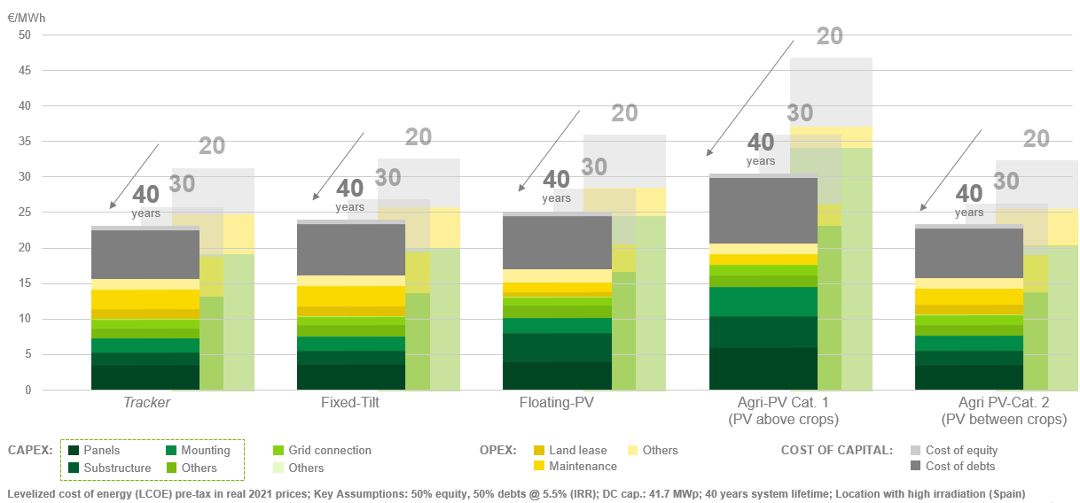
Comparison of LCOE between different large-scale PV applications and lifetimes
40% lower LCOE just because of a longer lifetime of the generator​

Slide 8
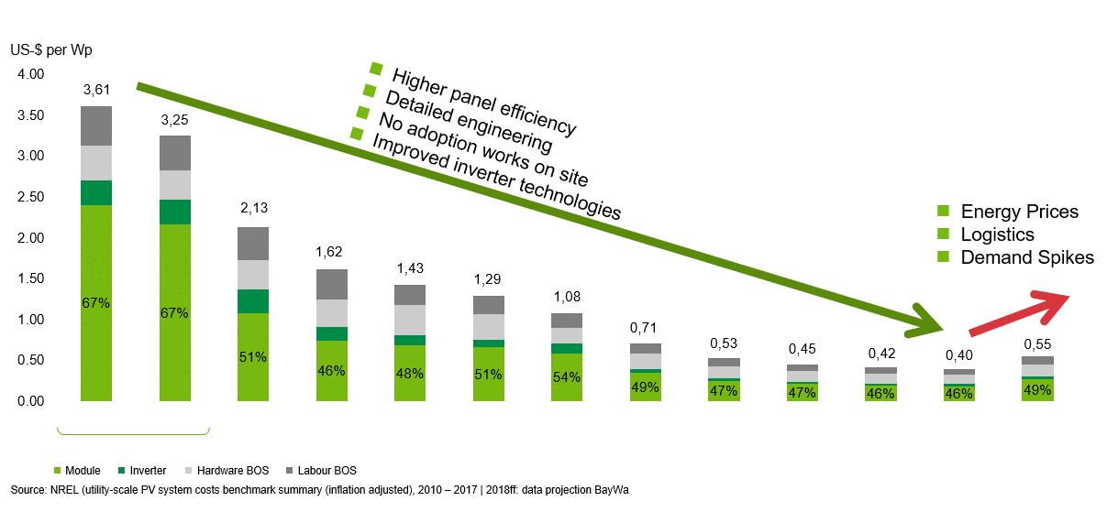
We emphasize minimizing LCOE, and our development of installation cost dropped by 20% per year

Slide 9
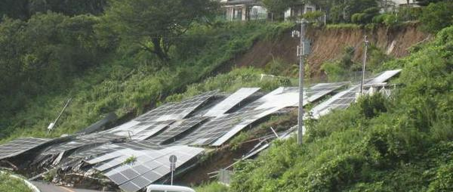
… 40 years lifetime?
unsufficient ground preparation
Earth

Slide 10
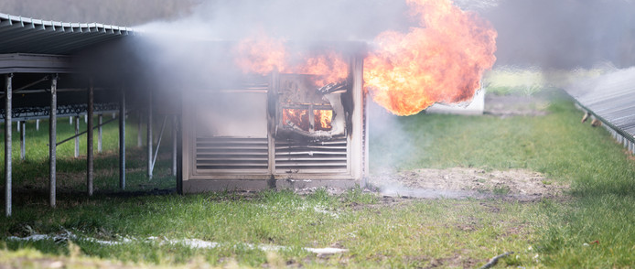
… 40 years lifetime?
unsufficient AC cabling
Fire

Slide 11
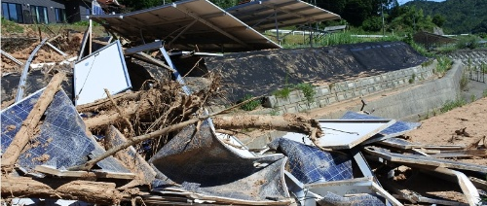
… 40 years lifetime?
unsufficient flood protection
Flooding

Slide 12
To offer the lowest LCOE means:
Use best quality components
Design long lasting projects
Standardization of concepts
Flexibility on spare parts & suppliers
Thorough engineering
‘… a poor man buys cheap, hence expensive’

Slide 13
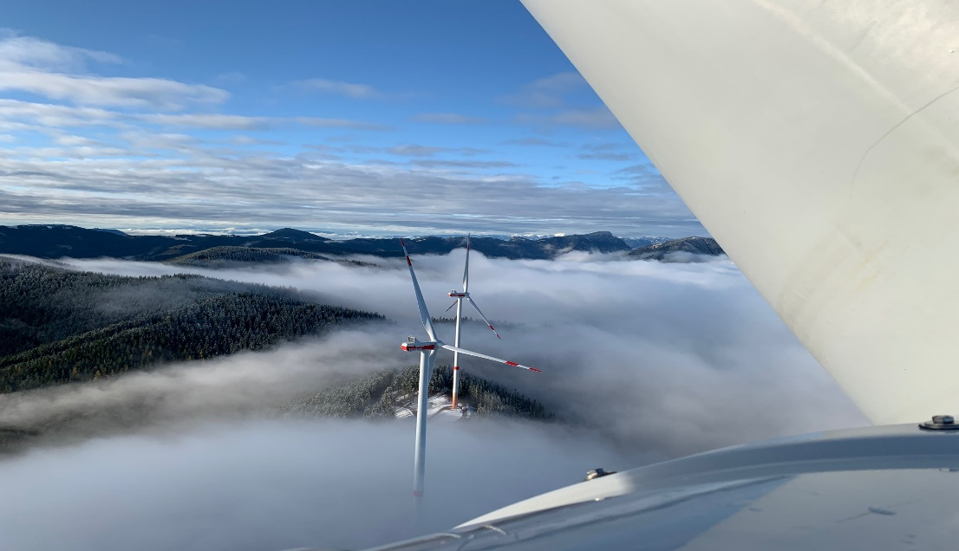
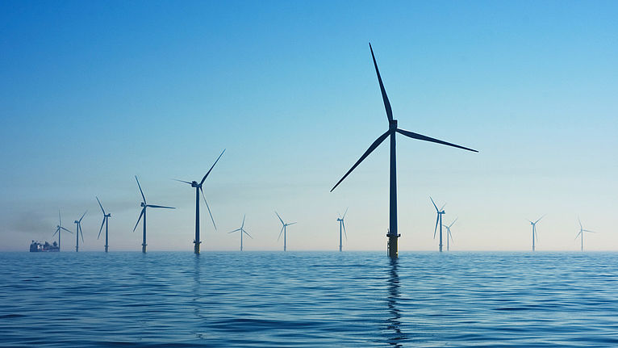
Our innovative approach going beyond PV – wind farms from mountain to sea
We have a history of successfully dealing with the complex demands of wind energy projects in semi-mountainous regions where temperatures, wind, snow, ice and altitude pose particular challenges for people, machines and equipment.
We are now also applying our innovative mindset, collaborative approach and project realization expertise in the offshore wind sector, with a 4GW offshore wind projects portfolio internationally.
Notes:
Why semi-mountainous regions for wind projects?
Semi-mountainous regions often consist of remote and less densely populated areas, reducing conflicts with other land uses and community concerns.
The elevation and natural wind channels in semi-mountainous regions can enhance the efficiency and reliability of wind energy generation
These areas typically face less competition for land use compared to flat, urban, or agricultural regions, making them suitable for wind projects
Why offshore wind?
Offshore wind power is forecast to become the largest source of electricity in the EU by 2040
Offshore sites often allow for larger-scale projects, accommodating more turbines, and also generating more energy due to stronger and more consistent wind speeds, therefore accelerating the development of large-scale renewable energy projects
Helps preserve valuable land resources for other uses, such as agriculture or urban development

Slide 14




The entire value chain from one single source
participation
in auctions
securing grid
connection
permissioning
process
(pre-)financing
and Interim financing
project
development
optimisation
of plant layout
What we are doing:
Providing project development expertise and bringing international PPA and financing experience to the Romanian market
profit simulation
and operating parameters
EPC
site analysis
and acquisition
commissioninig
direct marketing
of electricity
central 24/7 monitoring
and inspections
contracting PPAs
business and technical
operation management
sales
repowering/revamping
decommissioning/
recycling

Slide 15
Thank you!
BayWa r.e. Romania
  246C Calea Floreasca, Skytower Office Building, floor 12, District 1
  014476 Bucharest, Romania

